Slide 1
Each Child, Our Future and Ohio’s
Whole Child Framework
Paolo DeMaria, State Superintendent
August 4, 2020

Slide 2

Each Child,
Our Future
Ohio’s Strategic Plan for Education
education.ohio.gov/StrategicPlan

Slide 3
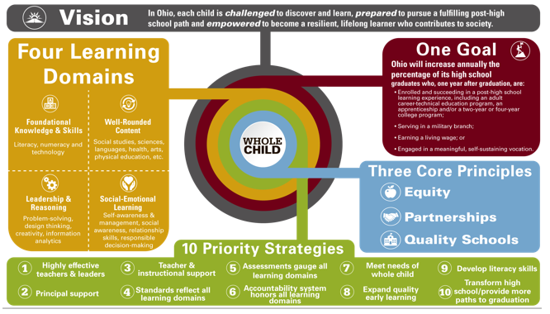
Each Child, Our Future

Slide 4

Strategy 8: Promote the importance of early learning and expand access to quality early learning experiences.

Slide 5
PreK-3 Strategy
Early Learning and Development Standards
Early Childhood Advisory Committee
Step-Up to Quality Programs; incentives
Alignment with Dept. of Job and Family Services
Connection to Head Start
Kindergarten Readiness Assessment
Literacy Emphasis – Diagnostic Assessments; Reading Guarantee
SEL Standards

Slide 6

Strategy 7: Work together with parents, caregivers and community partners to help schools meet the needs of the whole child.

Slide 7

Why Ohio’s Whole Child Framework?

Slide 8
Behavioral Health and Wellness Education Advisory Committee
Established in April 2018 by the State Board of Education
Focus on topics of social, emotional, mental and behavioral health including mental wellbeing, depression, anxiety, drug and alcohol use and abuse, bullying and harassment, trauma and suicide

Slide 9
Work of the Behavioral Health & Wellness Advisory Committee
Identified needs of schools and students
Reviewed existing resources
Identified gaps
Developed a Behavioral Health and Wellness Toolkit
Full report and 15 recommendations

Slide 10
Recommendations
Establish a whole school, whole community, whole child advisory committee
Develop a coherent framework for whole school, whole community and whole child activities
Ensure the integration of a whole child approach through the continuous improvement processes used by districts and schools

Slide 11
Whole Child Advisory Group
Established in September 2019
47 External Stakeholders
Internal Team

Slide 12

Whole Child Advisory Group Charge
Develop a whole school, whole community and whole child framework
Promote the value of a whole school, whole community and whole child approach
React to and inform guidance models and examples from Ohio districts to guide adoption and implementation

Slide 13
Work of the Past Eleven Months
Whole Child Advisory
Workgroups
Ideas for Innovation
Internal Team
Planning
Review of feedback
Framework
Notes:
Dave:
I’d like to share with you an overview of the work that has taken place over the last several months since the Whole Child Advisory was established.
In addition to the larger Advisory that I described to you, there were two smaller workgroups, one of which directly influenced the development of the draft framework. The second was a smaller workgroup which was engaged in the development of a process for districts to share their practices and initiatives that are aligned to the uses for the Student Wellness and Success Funds that were identified in the current biennial budget. Both workgroups groups were made up of interested individuals from the larger Whole Child Advisory.
And as I previously stated, we had an active and dedicated internal team working to support the recommendations of the Advisory and its workgroups.
NEXT SLIDE

Slide 14
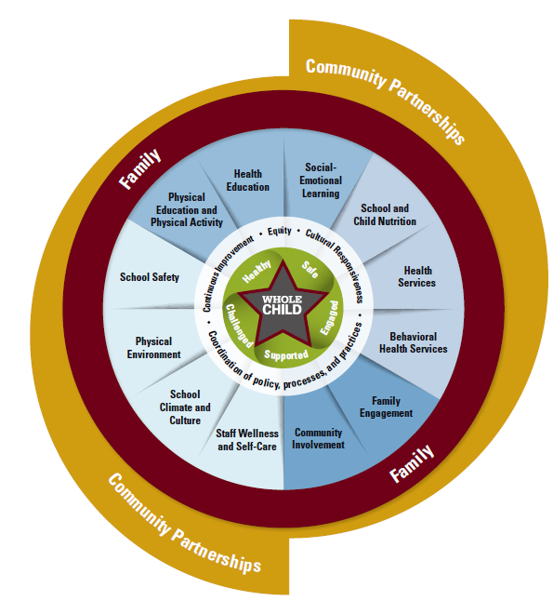
Ohio’s Whole Child Framework
Notes:
Jennifer
What you see here is the latest version of Ohio’s Whole Child Framework. You should have a copy in your board materials. We will spend time in a moment walking through each of the major parts of the framework.
You will notice that we are referring to the graphic that you see in front of you as Ohio’s Whole Child Framework and the narrative document as the framework’s supporting language.
In Each Child Our Future, Ohio’s strategic plan for education, the Department was charged with creating a whole child model for meeting students needs. Each component of the model when brought together is a holistic and comprehensive approach to meeting student’s needs. This Whole Child Framework creates the condition for students to thrive in school and to reach their full potential. The graphic representation was indeed that model with the narrative, helping to describe that model.
The model includes the student at the center with parents and families represented in red closest to the child
Immediately surrounding the student are the five tenets, healthy, safe, engaged, supported and challenged
In the white circle are foundational practices and processes that support a whole child model including equity, cultural responsiveness, continuous improvement and coordination of policy processes and practices
Then there are 12 components of a whole child model which include supports and actions that are provided by the school and those provided in partnership with families and community.
Finally, you have families and community that surround and support the needs of the whole child. And now I will go into more depth about each section of the model.
Next slide

Slide 15
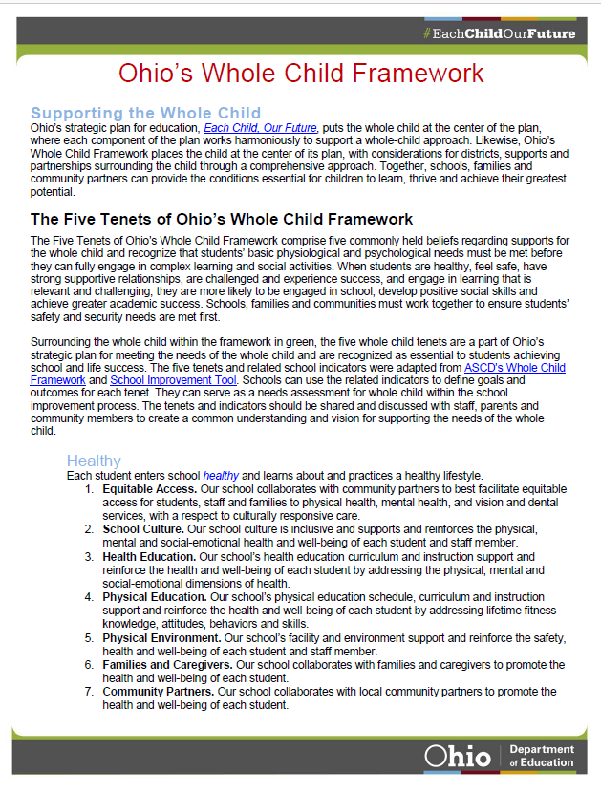
Ohio’s Whole Child Framework Supporting Document
Notes:
Jennifer
This is supportive language that explains each part of the whole child model. document that accompanies the framework and provides districts and schools with a high-level explanation of the framework components. Feel free to reference this document as we walk through the framework together.
The narrative language explains each framework component. It provides high-level detail about each section of the framework without getting into the implementation steps for each part.
This document is not meant to provide specifics as to how districts or schools put the framework into practice. Later in our presentation, Brittany will talk about the implementation phase of the framework. I will now give a brief summary of each component of the Framework.
As a reminder, you have this information in your board materials.
Next slide

Slide 16

Supporting the Whole Child
Notes:
Jennifer
The whole child is at the center of the Framework and all parts of the framework work harmoniously to provide a comprehensive system to support students whole child needs.
This section also emphasizes the importance of including student voice in decisions schools and districts make. Throughout the implementation of the framework, districts and schools are encouraged to welcome student voice in decisions around academic content, discipline, school culture, free time and family involvement.
Next slide

Slide 17

The Five Tenets of Ohio’s Whole Child Framework
Notes:
Jennifer
These are the 5 tenets of Ohio’s Whole Child Framework.
In Ohio’s Strategic Plan, strategy 7, Ohio was to adopt a whole child model and whole child approach which included these 5 tenets. Each tenet has 10 school indicators that can be used as goals, outcomes or measures to guide and assess their level of meeting students whole child needs in each area. I will now go over each tenet’s definition and provide a few examples of the indicators.
Healthy means each child enters school healthy and learns about and practices a healthy lifestyle. Indicators of healthy include students having equitable access to health services; health and physical education curriculum and instruction and engaging community partners to promote health and student well-being.
Safe is defined as each student learns in an environment that is physically and emotionally safe for students and adults. Indicators include schools upholding and modeling social justice and equity concepts; being trauma-informed and using a Positive Behavioral Interventions and Supports framework to prevent, intervene and support student safety.
Supported- means each student has access to personalized learning and is supported by qualified caring adults. Indicators include providing personalize learning using multi-dimensional teaching strategies, assessing student progress regularly and adjusting instruction accordingly. Supported also means supporting families in their role as equal partners in their child’s education as well as helping to support families needs.
Challenged means- In Ohio, each child is challenged to discover and learn and is prepared to pursue a fulfilling post-high school path and empowered to be a resilient lifelong learner who contributes to society. This is also Ohio’s vision in Each Child, Our Future. Indicators of challenged include students having access to challenging standards, evidence-based curriculum that challenges students to think about language and culture beyond their own individual experience and having high expectations for all students.
Engaged – means each student is actively engaged in learning and connected to the school and broader community. Indicators for engaged include educators using learning strategies that actively engage students such as cooperative and project-based learning, students are involved experiential learning activities and students are instructed in content that is relevant to their lived experience and those in the world.
Next slide

Slide 18
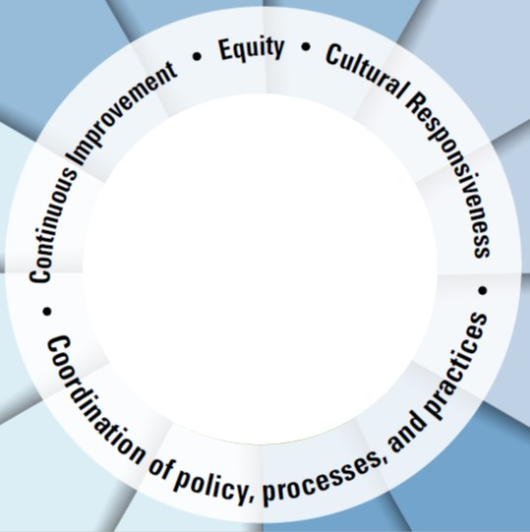
Systemic Practices for
Learning and Health
Equity
Cultural Responsiveness
Continuous Improvement
Coordination of Policy, Processes and Practices
Notes:
Jennifer
This section is the Systemic Practices for Learning and Health. – These are practices and processes that are foundational to the five tenets and 12 components of the framework. The Whole Child Framework is built on the principals and practices of Equity, Cultural Responsiveness, School Improvement and the coordination of policies, processes and practices.
In Ohio’s strategic plan, equity in education is defined as each child having access to relevant and challenging academic experiences and educational resources necessary for success across race, gender, ethnicity, language, disability, family background or income. To create an equitable system, districts and schools need to understand the unique challenges and barriers students face and implement policies, practices and programs to overcome those barriers. In this section, districts and schools are provided question to guide them in creating an equitable education system.
Culturally Responsive means, schools must develop culturally responsive pedagogy and practices to meet the needs of the whole child. Culturally responsive practice is an approach that respectively encompasses and recognizes both students and educators lived experiences, cultures and languages. Educators reflect on their own implicit bias and match instruction to their students’ cultural norms and social interactions. They also use instructional materials that represent and value their students’ diverse cultures and history.
It’s important to note districts are currently immersed in developing strategies to address the inequities that have always existed in our education system and have recently been illuminated by the pandemic. In creating Each Child Our Future, equity is one of the three pillars and is also one of our greatest challenges. In addition to equity, districts and schools are grappling with how to respond and address racial and social injustices that have existed for a long time and have come to light in the last couple months with the death of George Floyd.
Lastly, for successful implementation of a whole child framework to occur coordination of policies, processes and practices must happen at the state and local level. Districts and schools will need to incorporate the whole child framework as a part of the school and districts improvement process. Whole Child goals, strategies and activities are a critical part to their district and school improvement plan.
Next slide

Slide 19
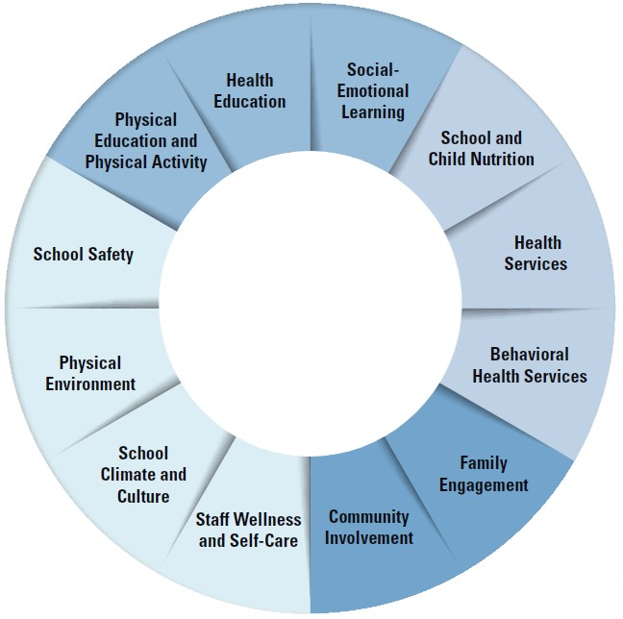
Components of School and Health Support Systems
Supporting Students in Developing Healthy Behaviors
Services to Students and Families
Engaging Others to Support Student Wellness and Success
Components of a Safe and Supportive School Environment
Notes:
Jennifer
These are the Components of the School and Health Support System.
They include supporting students healthy behavior, services to students and families, engaging others to support student wellness and success and components to create and safe and supportive learning environment
These 12 components are banded together by different shades of blues because those components work together to achieve the common goals listed on the slide. I will now briefly provide a brief summary of the components.
next slide

Slide 20
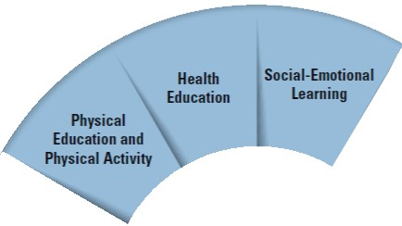
Supporting Students in Developing Healthy Behaviors
Health Education
Physical Education and Physical Activity
Social-Emotional Learning
Notes:
Jennifer
This slide shows the components that support students in developing healthy behaviors.
This section emphasizes that schools provide the structure that gives students knowledge and skills to make decisions to positively impact their health and social – emotional wellbeing.
These components highlight the importance of schools providing health and physical education content ,physical activities and social-emotional learning opportunities.
Educators teach content and provide physical activities for students to learn and practice healthy lifestyles. Teachers incorporate social emotional learning standards into their academic lessons and increase students self-awareness, self-management, social awareness, relationship skills and responsible decision making.
These content areas and learning opportunities build critical skills and behaviors necessary to create healthy, responsible and productive citizens.
Next slide

Slide 21
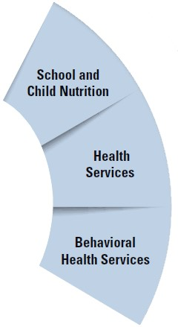
Services to Students and Families
School and Child Nutrition
Health Services
Behavioral Health Services
Notes:
Jennifer
schools provide services to students and families either directly in the school or through partnerships with the community organizations to support students health, nutrition, and behavioral health needs.
Schools provide students nutritious meals through school lunch programs,
Health services through school nurses or school-based health services and
behavioral health services that deliver prevention, counseling and psychological services.
School can also link families to services in the community that can help them obtain essential services to support needs such as food, clothing and shelter.
Next slide

Slide 22
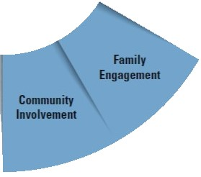
Engaging Others to Support Student Wellness and Success
Family Engagement
Community Involvement
Notes:
Jennifer
This section is centered on the importance of engaging families and communities in supporting student academic, social-emotional, health and wellness needs.
It is critical for schools to create systematic and multiple ways for families to engage and contribute to their child’s learning. This section provides specific actions schools can take to better engage families including activities that build strong, positive relationships, involving families in decision-making and finding multiple ways to keep families informed.
It is also essential that schools engage and collaborate with community partners. Community partners including businesses, churches, social service agencies and others can provide schools, students and families with resources to address whole child needs. Districts and schools need to reach out, share information and coordinate information and resources.
Next slide

Slide 23
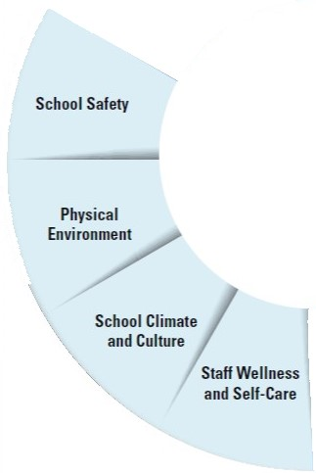
Components of a Safe and Supporting School Environment
School Climate and Culture
School Safety
Physical Environment
Staff Wellness and Self-care
Notes:
Jennifer
These are the Components of Safe and Supportive School Environment. These components are school climate and culture, school safety, physical environment and staff wellbeing.
a. School climate are the beliefs, values, attitudes and norms routinely demonstrated in the school including a commitment to equity, race and social justice.
b. School safety is about ensuring the emotional and physical safety of students.
c. Physical environment - Ensures the school building and surrounding environment is safe for students and staff, for example ventilation, noise and temperature. It is also ensures students are safe from physical threat including violence, crime, biological or chemical threat
d. Staff wellness and self-care – Explains staff wellness is a critical component to meeting whole child needs. In order for staff to meet the needs of their students; they must have their needs met first. Schools can promote staff wellness by creating employee wellness programs, sharing and encouraging staff to do self-care practices such as physical fitness, getting plenty of sleep and taking time for oneself.
Next slide

Slide 24
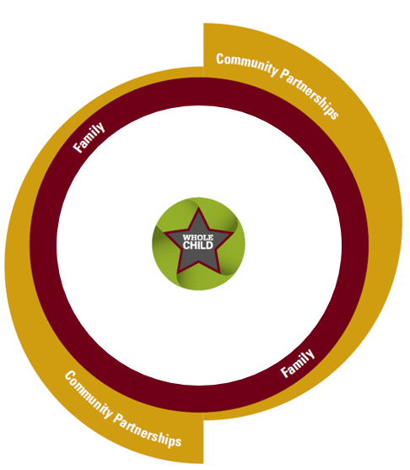
Partnerships
Families as Partners
Community Partners
Notes:
Jennifer
The last sections of the framework focus again on family and community partnerships.
In the framework, we call out families and communities as the outer ring to emphasize their importance to the success of meeting whole child needs.
Families and communities are a part of the larger ecosystem of which schools and students school experiences exists.
Families are the most critical support system for students and therefore it is important for schools to support and partner with families and build reciprocal relationships.
The same is true about partnering with communities. It is important that schools develop a reciprocal relationship with community organizations and those living in the surrounding community.
What occurs in community impacts students and the school; likewise what schools do impacts the community. After all, schools are educating those that may one day work and live in their community. Districts and schools need to engage communities in district and school planning.
At the same time, they also need participate in community planning and express the needs of their students and staff
and engage students and staff in activities that positively affect their community.
Next slide

Slide 25
Ohio’s Whole Child Framework
Notes:
Jennifer
All together the five tenets, 12 components and families and community come together to support students academic, health, safety and social –emotional needs. Districts and schools are already implementing many aspects of the framework. The Whole Child Framework is the foundation students need to be successful, focused and engaged in learning. These are the building blocks for student success in school and in life.
Next, I will turn the presentation over to Brittany Miracle who will explain our next steps for implementation.
Next slide

Slide 26

Implementation and Next Steps
Notes:
Brittany

Slide 27






@OHEducation

Slide 28
Transitions and Learning Supports in a Pandemic Context
Panelists:
Andrea Brinnel, IDEA Part 619 Part B Manager, Connecticut State Department of Education
Jane Walsh, Early Education Department, Denver Public Schools (CO)
Lauren Zbyszinski, Inter-agency Deputy Director of Early Childhood, Texas Education Agency
Moderator:
Kristie Kauerz, Director, National P-3 Center, University of Colorado Denver
Session 2

Slide 29




Transitions During COVID-19
CONNECTICUT STATE DEPARTMENT OF EDUCATION
Andrea Brinnel, Ed.D.
619 Part C Manager, Early Childhood Specialist
CT State Department of Education
andrea.Brinnel@ct.gov
860-713-6941

Slide 30

Collaborations are Key
CT State Department of Education
CT Association of Schools
The Connecticut Office of Early Childhood
The CT Regional Education Service Center (RESC) Alliance
CONNECTICUT STATE DEPARTMENT OF EDUCATION

Slide 31
Transitions
Executive Order
Part C to Part B Transitions and FAPE at Three
Flowchart
Joint Memo
Transitioning to Kindergarten during a Public Health Emergency
CONNECTICUT STATE DEPARTMENT OF EDUCATION

Slide 32

ESSA Transition Resources
CONNECTICUT STATE DEPARTMENT OF EDUCATION

Slide 33
Five Core Values that Guide Effective Transition Practices
Collaborative, responsive, and trusting relationships with families.
Ongoing communication with all stakeholders- including families, program staff, and others.
Respect for diverse linguistic/cultural backgrounds and experiences, strengths, and needs of children and families.
Positive relationships between adults and children as foundations for children’s learning and development.
Competent, knowledgeable staff to implement transition practices
CONNECTICUT STATE DEPARTMENT OF EDUCATION

Slide 34
Guiding Principle 1: Collaborative, responsive, and trusting relationships with families
Across all Potential Models | Involve families and community members in planning. Plan should show sensitivity toward individual family context and needs (e.g., other children, working schedule out of the home and in home). Consider new and innovative ways of connecting with families such as Parent teacher Home Visiting (PTHV).
Return to School | Consider families’ concerns about health and safety. Consider increased challenges families will face with the transition to a school routine under the current circumstances (e.g., getting school clothes, adjusting family routine after a long period of being home). Consider practices related to school supplies and materials in light of safety and increased family economic challenges. Be aware of challenges families may continue to face due to health or loss of resources (e.g., income, access to technology) that may impact their ability to participate in school-based events. Explore non-traditional forms of family engagement.
Continued Distance Learning | Ask for family input about how they are able to support learning at home. Consider families’ needs and priorities when planning the role they will play in distance learning. Work with families to determine their educational priorities. Consider developmentally appropriate distance learning for young children. Incorporate strategies that encourage active engagement and physical activity and limit screen time.
Hybrid | Consider families’ needs for child care during the planning process. Work with individual families to support them in a transition to a new model of schooling. Provide a forum for families to express their needs and challenges.

Slide 35


Slide 36


Leadership
Reopening Round Table Conversation for Preschool and Kindergarten Administrators
A collaborative effort between
The CT State Department of Education
The CT Office of Early Childhood
The CT Regional Education Service Center Alliance
The CT Association of Schools
CONNECTICUT STATE DEPARTMENT OF EDUCATION

Slide 37

Andrea Brinnel, Ed.D.
619 Part C Manager, Early Childhood Specialist
CT State Department of Education
andrea.Brinnel@ct.gov
860-713-6941
CONNECTICUT STATE DEPARTMENT OF EDUCATION

