Slide 1
Coordination Case Study: An Illustrative Example from California
Presenters:
Deborah Stipek, Professor of Education, Stanford University and Faculty Director, DREME
Deanna Mathies, Director of Early Learning, Fresno Unified School District (CA)
Moderator: Kristie Kauerz, Director, National P-3 Center, University of Colorado Denver
Session 5

Slide 2
PreK-3 Alignment:
Challenges and Opportunities
Deborah Stipek
Stanford University
Professor
Deanna Mathies
Fresno Unified School District Executive Officer
Early Learning Division
dreme.stanford.edu

Slide 3
What is PreK-3 Alignment?
Providing children with a seamless educational experience in which each grade builds on what was learned in the previous grade as children move from preschool through the early elementary grades,
  with the goal of sustaining the gains made in preschool and leading to better developmental and learning outcomes overall.

Slide 4
standards, assessments, teacher credentialing & pay
State
Vertical alignment/Congruence across levels
textbooks, professional development, assessments, pacing guides, staffing, data
District
textbooks, professional development, assessments, pacing guides, staffing, data
School
instruction, teaching materials, assessment, family involvement, data
Classroom
Horizontal alignment/Continuity across time and grade levels

Slide 5

Instructional Coherence
Instruction in each grade
is coherent within the discipline
builds on skills developed in previous grade
is targeted just beyond students’ skill levels
uses similar pedagogical approaches
provides opportunities for students to broaden and deepen their skills by applying them in novel contexts

Slide 6
Mathematical Coherence

Slide 7
Pedagogical Coherence
From a classroom in which: | To a classroom in which:
Manipulatives are commonly available and used to represent ideas (as “thinking tools”) | Manipulatives are used infrequently, often for “demonstration” only and most of children’s work involves paper and pencil
Children frequently work in dyads or groups | Children work alone
The teacher asks children to figure out different ways to solve problems | The teacher stresses using a particular, method for generating answers to problems
The teacher expects children to explain why an answer is correct and how they found their answers | The teacher focuses only on the correctness of answers
It is important to be able to solve problems correctly but also to be able to analyze incorrect answers and invalid reasoning | Getting the right answer is emphasized
Speed is less important than reasoning (but fluency in core skills is developed) | Speed is emphasized

Slide 8





The DREME COHERE Study
  What policies at the district level promote productive continuity at the classroom level?
  How are district policies mediated by policies and practices at the school level?
  How are policies and practices at the district and school levels affected by state policies?

Slide 9
Goals
Document districts’ and schools’ efforts to create alignment and continuity between preK and early elementary mathematics
Investigate how these efforts are experienced by teachers and students
Measure how these efforts influence students’ learning opportunities, perceptions of mathematics, and proficiency

Slide 10
District level: Two midsize California school districts
  Interviewed district leaders in curriculum & instruction, early education, and leadership
  Observed professional development in all three divisions
School level: Three schools per district with PreKs on site, supervised by principals
  Interviewed school leaders (principal, AP, coaches)
  Interviewed and surveyed teachers PreK – 2
Classroom level:
  Three classroom observations (Fall, winter, spring) + debrief interview
  Surveyed teachers PreK – 2
Student level: all students with parental consent
  Mathematics assessment fall and spring (REMA-SF)
  Student interviews (meaning of math and perceptions of ability)
Method
District level: 2 midsize California districts
  Interviewed district leadership and leaders in Curriculum & Instruction and Early Education
  Observed professional development in all three divisions
School level: 3 schools per district with preKs on site supervised by principals
  Interviewed school leaders (principal, AP, coaches)
  Interviewed and surveyed teachers preK – 2 about school practices
Classroom level:
  3 classroom observations (fall, winter, spring) + debrief interview
  Interviewed teachers preK – 2 about classroom practices
Student level:
  Mathematics assessment fall and spring (REMA-SF)
  Student interviews (meaning of math and perceptions of ability)

Slide 11
Approaches to Alignment
Organizational
  Early Learning Director involved in district decision making
  communication among administrators from different departments
  preschool is under elementary school principal
  moving K into early learning department
Alignment of standards, assessment and curriculum
Professional development/collaboration
  teachers across grades engage in communities of practice, PD, have common coaches
  principal & curriculum and instruction leadership training in ECE

Slide 12
Approaches to Alignment (Cont.)
Processes
  instructional walkthroughs
  teachers sharing data across years
  kindergarten readiness assessments used to plan instruction
  prek included in district strategic plans
Tools
  integrated data system
  instructional practice guide that documents specific high-leverage pedagogical strategies to be used across grades

Slide 13
Challenges of Fostering Alignment: School Level
Physical separation of preK from other grades
Children from multiple preschool programs entering kindergarten (children in preK move to different elementary schools)
Status issues that come from different credentialing and pay for preK compared to elementary teachers
Different schedules for preK and elementary teachers
Dearth of curricula and assessment that span prek-3
PreK and K-3 teachers’/leaders’ different beliefs about appropriate instruction

Slide 14
Challenges of Fostering Alignment: District Level
Two (or more) sets of preK rules and regulations for school leaders to learn (knowledge & paperwork burden)
Different funding sources and expectations related to PD for preK and K-12 teachers
Lack of facilities on elementary school campus for preK
Leaders’ weak knowledge of ECE
Department silos
Not convinced of the value of preK or perception that preK serves a different purpose from elementary grades and disconnect is appropriate

Slide 15
Challenges of Fostering Alignment: State Level
Different funding sources for preK and K-12
Complicated and varying funding policies and varying program standards for preK
Absence of continuous assessment system preK-2
Absence of data system linking preK to K
Disconnect between preK and K learning standards
Disconnect between preK and K-12 accountability mechanisms
Disconnect between preK and elementary teacher preparation, licensing, and pay

Slide 16
Key Lessons Learned
Districts need to:
make organizational changes that integrate preschool into elementary school planning and governance;
bridge the silos and create opportunities for district leaders in different departments to work and learn together;
provide ongoing learning opportunities to school leaders who have responsibility for early learning and instruction;
focus on curriculum and pedagogy alongside aligned approaches to instructional leadership and a system of instructional supports
align curricula and assessments across preK and the early elementary grades
make an explicit effort to include instruction in initiatives designed to promote pre-K to elementary alignment and continuity

Slide 17
Key Lessons Learned
States need to:
provide encouragement/incentives for districts to create greater alignment and continuity between preK and elementary grades
streamline prek state funding
align preK and K standards, assessments, and curriculum guidelines
create greater alignment in teacher education, credentialing, accountability, and pay for preK and early elementary grade teachers
include early childhood as part of principal credentialing
create data system, including student assessment, that links preK-grade 2 to grades 3-12
provide financial support for preK facilities on elementary campuses

Slide 18

dreme.stanford.edu

Slide 19
Leadership Development to Enact Pre-K-3rd Grade
Work
Presenters:
Bobbie Burnham and Mike Brown, Minnesota Department of Education
Erika Hunt, Center for Study of Education Policy, Illinois State University
Gracie Branch, National Association of Elementary School Principals
Jean Allen, Alabama Department of Early Childhood Education
Kristie Kauerz, National P-3 Center, University of Colorado Denver
Session 6

Slide 20
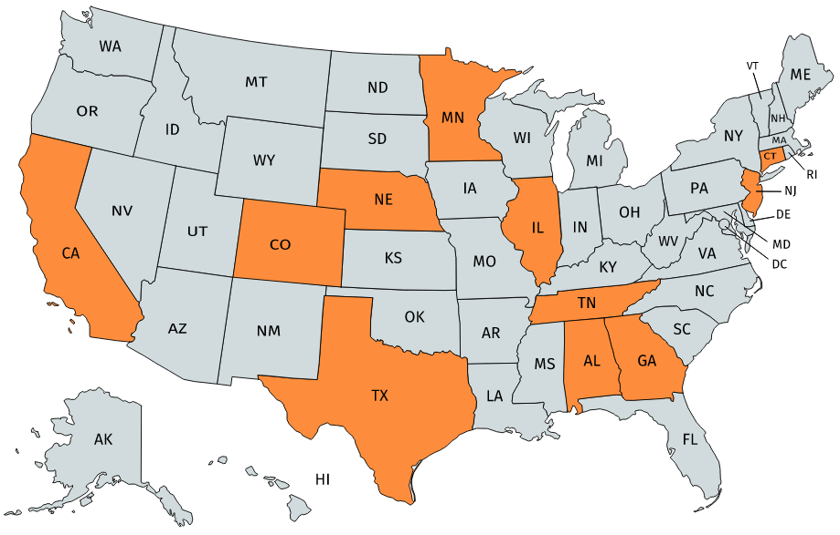
Map of P-3 Leadership Programs
Notes:
Mapchart.net

Slide 21
P-3 Leadership Programs
State Education Agency
Legislation re: Principal Preparation
NAESP in collaboration with state agency
Institution of Higher Education

Slide 22
Leadership Development to Enact Pre-K-3rd Grade Work
Bobbie Burnham| Mike Brown
August 6, 2020

Slide 23
Timeline of MDE’s P3 Professional Learning Engagement
2011: The "Better Schools for a Better Minnesota" PreK to Grade 3 Systems for Success
2011-12: Making it Work: Implementing a Comprehensive PreK-3rd Grade Approach - Harvard
2013-14: PreK-3rd Grade Leadership Institute
2015-16: P3 Principal Leadership Series
2016-17: P3 Principal Leadership Series, Building Rigorous and Robust PreK-3 Learning Environments, and Building P3 Systems: From Alignment to Coherence
2018: National P-3 Institute: Implementing Comprehensive P-3 Approaches - Colorado
2018-19: Regional P3 Leadership Workshops
2019-20: P3 Regional Collaboratives

Slide 24
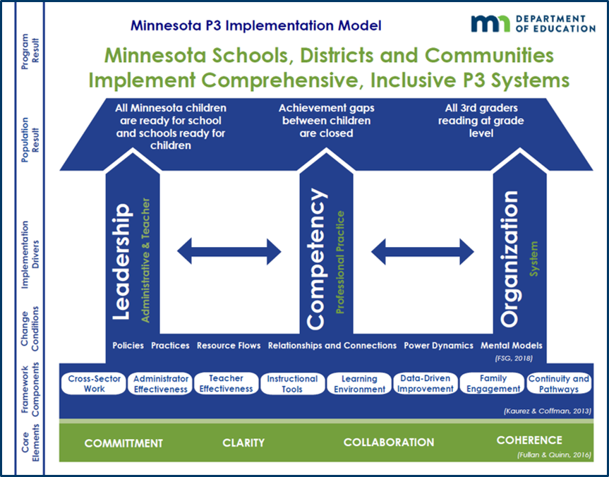
“Theory of Change” – MN P3 Implementation Model
Vision: Ensuring every child receives a quality education, no matter their race or zip code.
Mission: Minnesota Schools, Districts and Communities Implement Comprehensive, Inclusive P3 Systems.

Slide 25
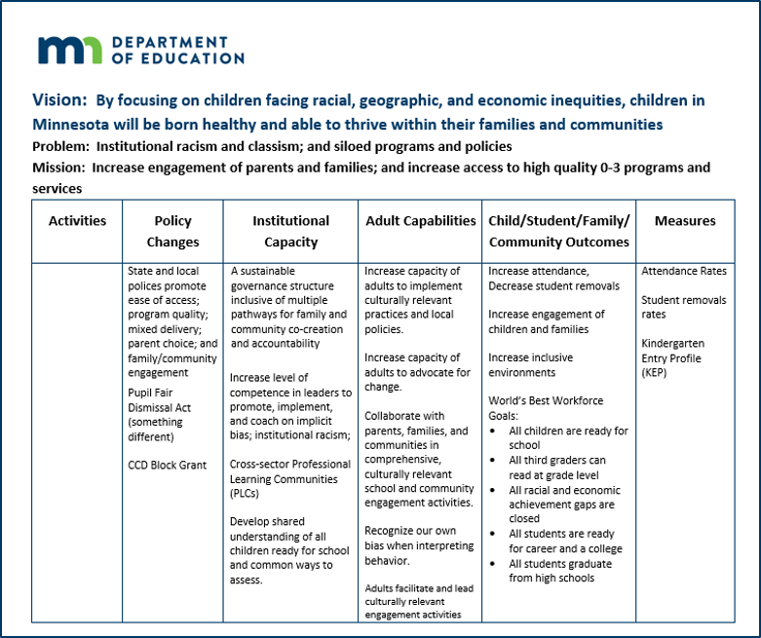
Theory of Change

Slide 26
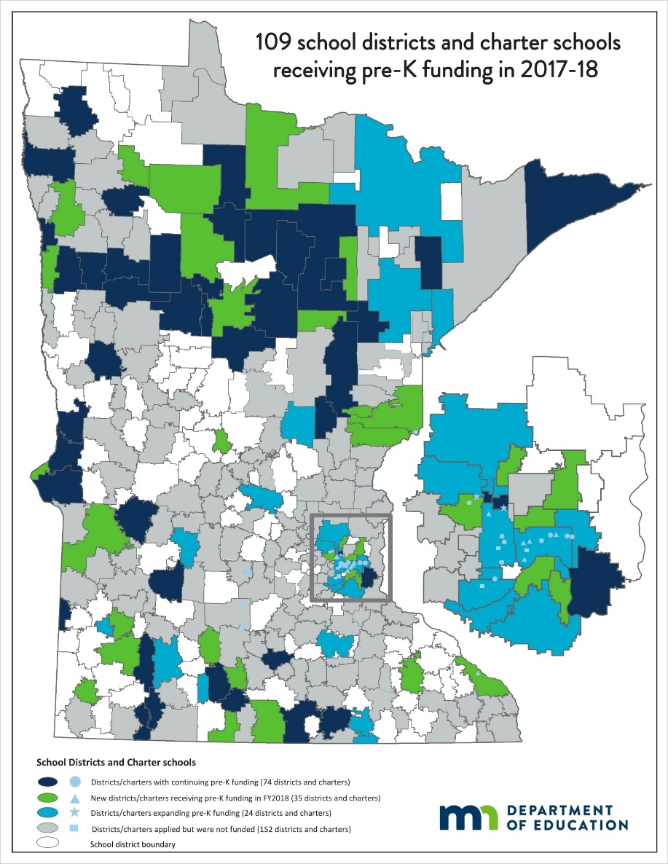
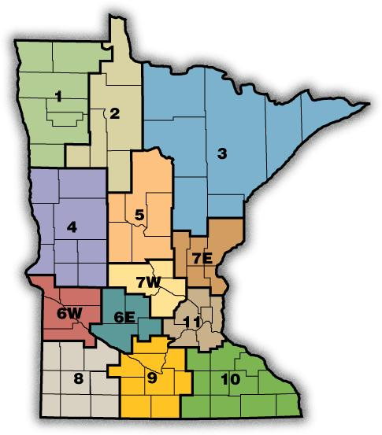
Statewide Reach

Slide 27
Sustainability
Title II Funding
P3 built into division strategic plan.
MDE staff design and deliver integrated professional learning opportunities.
  Building online professional learning modules.
P3 elements built into early childhood program legislation.
  Coordinate appropriate kindergarten transition with families, community-based prekindergarten programs, and school district kindergarten programs.
  Implement strategies that support the alignment of professional development, instruction, assessments, and prekindergarten through grade 3 curricula.
  Family engagement strategies that include culturally and linguistically responsive activities in prekindergarten through third grade that are aligned with ECFE (Early Childhood Family Education is a parenting education program).

Slide 28


Key Partners
Superintendents | Legislators
School Boards | Policy and Decision Makers
Parent and Family Educators | Professional Organizations
Higher Education | Head Start
Other Divisions within MDE: Data Analytics, Achievement and Integration

Slide 29



RESOURCES
CSEP, ISBE, and IBHE were recognized 2014 with the ECS Frank Newman Award for State Innovation for the Principal Preparation Reform work.
Hunt, Haller, Hood & Kincaid (April 2019). Reforming Principal Preparation at the State Level: Perspectives on Policy Reform from Illinois documents the entire policy journey from legislative to implementation to continuous improvement.
Preparing Principals for Pre-K in Illinois: The Prairie State's Story of Reform and Implementation (Lieberman, 2019) includes a history of Illinois’ Principal Preparation reform, a look at how implementation has fared nearly a decade later, and offers lessons and recommendations for states looking to ensure principals are equipped to lead pre-K and early grade classrooms.
This video series, funded by the Wallace Foundation, shows how Illinois successfully revamped requirements for preparation of principals.
More information about Illinois’ Principal Preparation Reform work can be found at: https://education.illinoisstate.edu/csep/publications/principal.php
Leaders who are interested in exploring how to be better informed PreK-3 leaders can check out:
  PK3 Teach Lead Grow website: https://pk3teachleadgrow.org/
  B-3 Continuity Project webpage: https://education.illinoisstate.edu/csep/b3/
Dr. Erika Hunt
309/310-3941
elhunt@ilstu.edu

Slide 30


NAESP Pre-K–3 Leadership Academy
IN COLLABORATION WITH
Council of Leaders of Alabama Schools (CLAS)

Slide 31
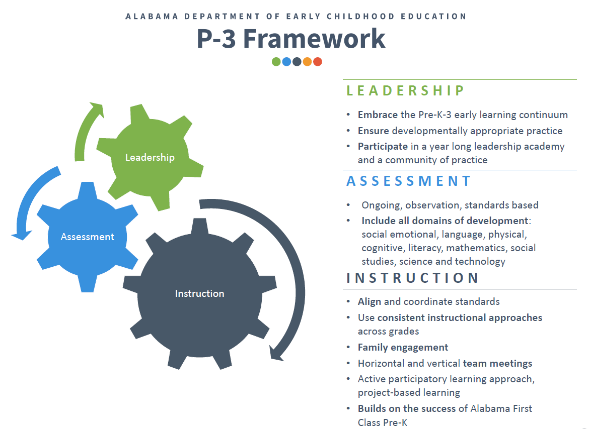

Slide 32
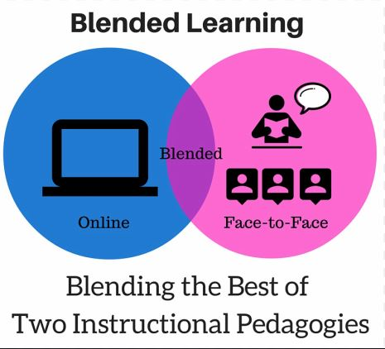

NAESP Pre-K-3 Leadership Academy Structure
2 Online Courses combined with Capstone Project that allows students to apply their learning within their own school setting
Plus 3 Face-to-Face Meetings for Collaboration and Networking with Larger Cohort at CLAS Offices
Guided Group Discussions in Learning Management System with Monthly Virtual Meetings

Slide 33
Institution of Higher Education Approach
Credit-bearing
Can support state-sanctioned professional pathways
Respected place to receive high-quality education and professional learning

Slide 34

www.nationalp-3center.org

