Slide 1
Leadership Development to Enact Pre-K-3rd Grade
Work
Presenters:
Bobbie Burnham and Mike Brown, Minnesota Department of Education
Erika Hunt, Center for Study of Education Policy, Illinois State University
Gracie Branch, National Association of Elementary School Principals
Jean Allen, Alabama Department of Early Childhood Education
Kristie Kauerz, National P-3 Center, University of Colorado Denver
Session 6

Slide 2
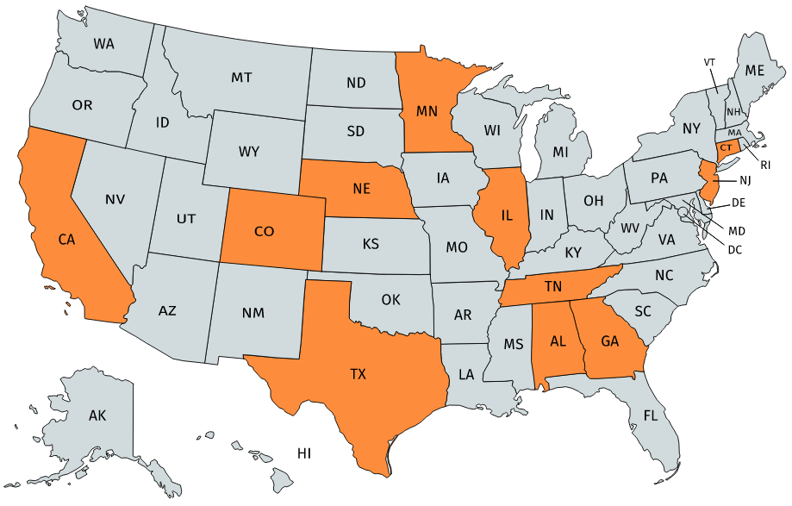
Map of P-3 Leadership Programs
Notes:
Mapchart.net

Slide 3
P-3 Leadership Programs
State Education Agency
Legislation re: Principal Preparation
NAESP in collaboration with state agency
Institution of Higher Education

Slide 4
Leadership Development to Enact Pre-K-3rd Grade Work
Bobbie Burnham| Mike Brown
August 6, 2020

Slide 5
Timeline of MDE’s P3 Professional Learning Engagement
2011: The "Better Schools for a Better Minnesota" PreK to Grade 3 Systems for Success
2011-12: Making it Work: Implementing a Comprehensive PreK-3rd Grade Approach - Harvard
2013-14: PreK-3rd Grade Leadership Institute
2015-16: P3 Principal Leadership Series
2016-17: P3 Principal Leadership Series, Building Rigorous and Robust PreK-3 Learning Environments, and Building P3 Systems: From Alignment to Coherence
2018: National P-3 Institute: Implementing Comprehensive P-3 Approaches - Colorado
2018-19: Regional P3 Leadership Workshops
2019-20: P3 Regional Collaboratives

Slide 6
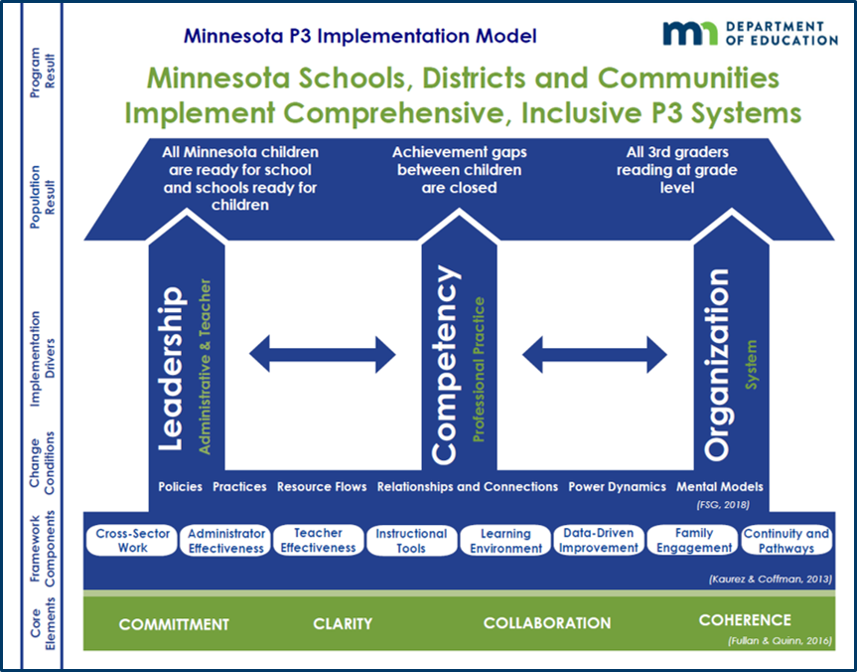
“Theory of Change” – MN P3 Implementation Model
Vision: Ensuring every child receives a quality education, no matter their race or zip code.
Mission: Minnesota Schools, Districts and Communities Implement Comprehensive, Inclusive P3 Systems.

Slide 7
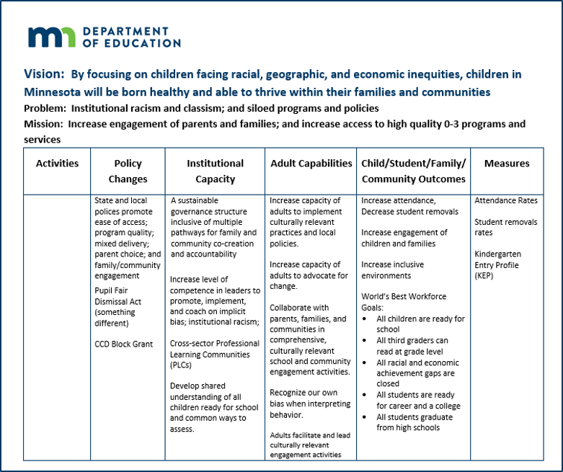
Theory of Change

Slide 8
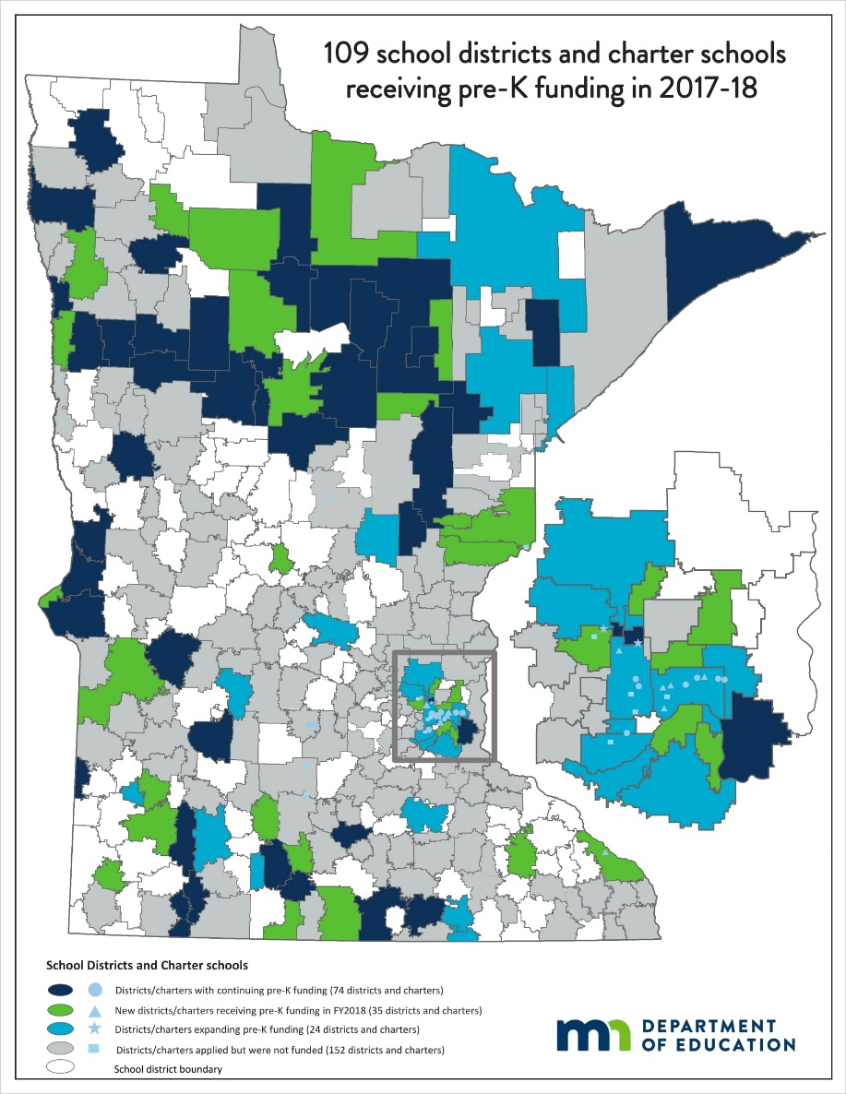
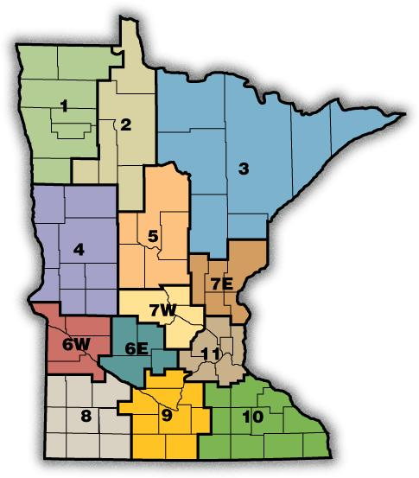
Statewide Reach

Slide 9
Sustainability
Title II Funding
P3 built into division strategic plan.
MDE staff design and deliver integrated professional learning opportunities.
  Building online professional learning modules.
P3 elements built into early childhood program legislation.
  Coordinate appropriate kindergarten transition with families, community-based prekindergarten programs, and school district kindergarten programs.
  Implement strategies that support the alignment of professional development, instruction, assessments, and prekindergarten through grade 3 curricula.
  Family engagement strategies that include culturally and linguistically responsive activities in prekindergarten through third grade that are aligned with ECFE (Early Childhood Family Education is a parenting education program).

Slide 10


Key Partners
Superintendents | Legislators
School Boards | Policy and Decision Makers
Parent and Family Educators | Professional Organizations
Higher Education | Head Start
Other Divisions within MDE: Data Analytics, Achievement and Integration

Slide 11

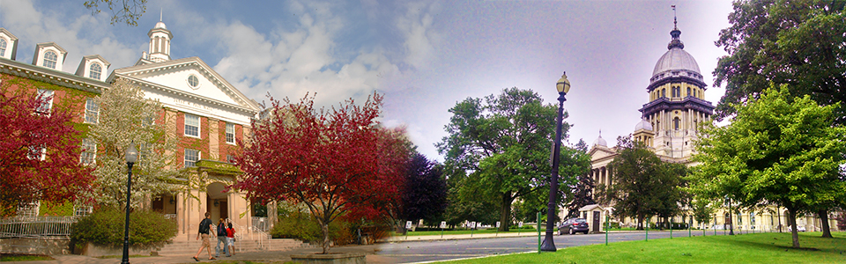

RESOURCES
CSEP, ISBE, and IBHE were recognized 2014 with the ECS Frank Newman Award for State Innovation for the Principal Preparation Reform work.
Hunt, Haller, Hood & Kincaid (April 2019). Reforming Principal Preparation at the State Level: Perspectives on Policy Reform from Illinois documents the entire policy journey from legislative to implementation to continuous improvement.
Preparing Principals for Pre-K in Illinois: The Prairie State's Story of Reform and Implementation (Lieberman, 2019) includes a history of Illinois’ Principal Preparation reform, a look at how implementation has fared nearly a decade later, and offers lessons and recommendations for states looking to ensure principals are equipped to lead pre-K and early grade classrooms.
This video series, funded by the Wallace Foundation, shows how Illinois successfully revamped requirements for preparation of principals.
More information about Illinois’ Principal Preparation Reform work can be found at: https://education.illinoisstate.edu/csep/publications/principal.php
Leaders who are interested in exploring how to be better informed PreK-3 leaders can check out:
  PK3 Teach Lead Grow website: https://pk3teachleadgrow.org/
  B-3 Continuity Project webpage: https://education.illinoisstate.edu/csep/b3/
Dr. Erika Hunt
309/310-3941
elhunt@ilstu.edu

Slide 12


NAESP Pre-K–3 Leadership Academy
IN COLLABORATION WITH
Council of Leaders of Alabama Schools (CLAS)

Slide 13
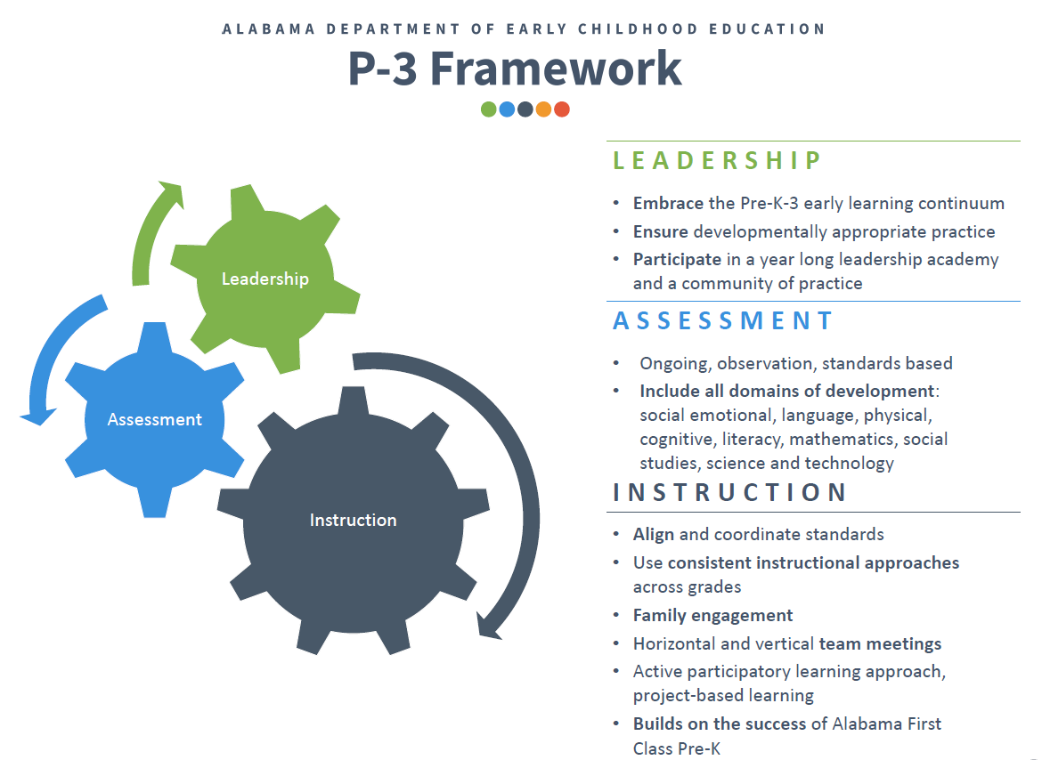

Slide 14
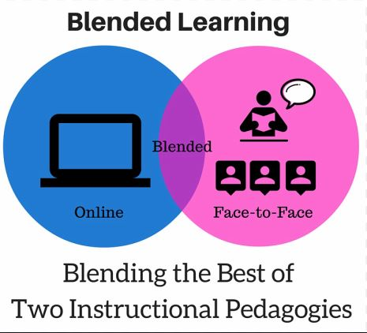

NAESP Pre-K-3 Leadership Academy Structure
2 Online Courses combined with Capstone Project that allows students to apply their learning within their own school setting
Plus 3 Face-to-Face Meetings for Collaboration and Networking with Larger Cohort at CLAS Offices
Guided Group Discussions in Learning Management System with Monthly Virtual Meetings

Slide 15
Institution of Higher Education Approach
Credit-bearing
Can support state-sanctioned professional pathways
Respected place to receive high-quality education and professional learning

Slide 16

www.nationalp-3center.org

