Slide 1
Transitions and Learning Supports in a Pandemic Context
Panelists:
Andrea Brinnel, IDEA Part 619 Part B Manager, Connecticut State Department of Education
Jane Walsh, Early Education Department, Denver Public Schools (CO)
Lauren Zbyszinski, Inter-agency Deputy Director of Early Childhood, Texas Education Agency
Moderator:
Kristie Kauerz, Director, National P-3 Center, University of Colorado Denver
Session 2

Slide 2




Transitions During COVID-19
CONNECTICUT STATE DEPARTMENT OF EDUCATION
Andrea Brinnel, Ed.D.
619 Part C Manager, Early Childhood Specialist
CT State Department of Education
andrea.Brinnel@ct.gov
860-713-6941

Slide 3

Collaborations are Key
CT State Department of Education
CT Association of Schools
The Connecticut Office of Early Childhood
The CT Regional Education Service Center (RESC) Alliance
CONNECTICUT STATE DEPARTMENT OF EDUCATION

Slide 4
Transitions
Executive Order
Part C to Part B Transitions and FAPE at Three
Flowchart
Joint Memo
Transitioning to Kindergarten during a Public Health Emergency
CONNECTICUT STATE DEPARTMENT OF EDUCATION

Slide 5

ESSA Transition Resources
CONNECTICUT STATE DEPARTMENT OF EDUCATION

Slide 6
Five Core Values that Guide Effective Transition Practices
Collaborative, responsive, and trusting relationships with families.
Ongoing communication with all stakeholders- including families, program staff, and others.
Respect for diverse linguistic/cultural backgrounds and experiences, strengths, and needs of children and families.
Positive relationships between adults and children as foundations for children’s learning and development.
Competent, knowledgeable staff to implement transition practices
CONNECTICUT STATE DEPARTMENT OF EDUCATION

Slide 7
Guiding Principle 1: Collaborative, responsive, and trusting relationships with families
Across all Potential Models | Involve families and community members in planning. Plan should show sensitivity toward individual family context and needs (e.g., other children, working schedule out of the home and in home). Consider new and innovative ways of connecting with families such as Parent teacher Home Visiting (PTHV).
Return to School | Consider families’ concerns about health and safety. Consider increased challenges families will face with the transition to a school routine under the current circumstances (e.g., getting school clothes, adjusting family routine after a long period of being home). Consider practices related to school supplies and materials in light of safety and increased family economic challenges. Be aware of challenges families may continue to face due to health or loss of resources (e.g., income, access to technology) that may impact their ability to participate in school-based events. Explore non-traditional forms of family engagement.
Continued Distance Learning | Ask for family input about how they are able to support learning at home. Consider families’ needs and priorities when planning the role they will play in distance learning. Work with families to determine their educational priorities. Consider developmentally appropriate distance learning for young children. Incorporate strategies that encourage active engagement and physical activity and limit screen time.
Hybrid | Consider families’ needs for child care during the planning process. Work with individual families to support them in a transition to a new model of schooling. Provide a forum for families to express their needs and challenges.

Slide 8


Slide 9


Leadership
Reopening Round Table Conversation for Preschool and Kindergarten Administrators
A collaborative effort between
The CT State Department of Education
The CT Office of Early Childhood
The CT Regional Education Service Center Alliance
The CT Association of Schools
CONNECTICUT STATE DEPARTMENT OF EDUCATION

Slide 10

Andrea Brinnel, Ed.D.
619 Part C Manager, Early Childhood Specialist
CT State Department of Education
andrea.Brinnel@ct.gov
860-713-6941
CONNECTICUT STATE DEPARTMENT OF EDUCATION

Slide 11
Lauren Zbyszinski
Texas Education Agency

Slide 12
Our Current Reality
The pandemic and subsequent rapid evolution of school models has further illuminated inequities that have always existed.
Students of color, students experiencing poverty, and emerging bilingual students have had less access to rich, engaging instruction at grade-level. This was exacerbated in the spring.
Teachers have had to perform a daunting task – recreating materials to serve the needs of students across fully in-person, hybrid, and full remote settings.
Access to the technology required to engage virtually is varied and there’s an added challenge in providing appropriate remote instruction for young learners (Pre-K-2) and diverse learners.
Source: Instruction Partners

Slide 13
High-Quality Instructional Materials for PK
Integrated content across all 10 domains of the Texas Prekindergarten Guidelines:
Developmentally appropriate practice​
Emphasis on health and wellness, language and literacy development, and play ​
Usability for both on-campus and remote settings
Usability and additional supports for families
Includes supports for students with disabilities and English Learners ​
​
Strong progress monitoring

Slide 14
Pathways – Adapt or Adopt
Considerations for adapting or adopting
Do my materials align to the key features of high-quality instructional materials and the needs for remote learning? What are the gaps?
Based on the gaps we identified, what would need to be adapted to create alignment?
Based on the gaps we identified, what are my options to adopt?
What are the capacity, allocation, and time needs to create alignment?
What are the capacity, allocation, and time needs to adopt?
What pathway supports meeting what I want to be true for teaching, learning, and student support across all models?
Resource: TEA School System Reflection Tool
Source: Instruction Partners

Slide 15
High-Quality Instructional Materials (HQIM) and COVID-19
The Challenge
HQIM
Alleviate the burden of designing lessons, adapting them to work both in person and remotely, and supporting cohorts of students with diverse needs.
Teachers developing their own curricula had a difficult time adapting to remote learning in the spring.
Those supporting teachers must help teachers optimize their teaching for each and every student.
Make it easier for principals and coaches to support all teachers, despite changing teaching and learning scenarios.
Schools are relying on groups of adults for an unprecedented amount of student support, care, and guidance.
Provide consistency and predictability for those supporting adults, while teachers remain the core instructors.
Source: Instruction Partners

Slide 16



THL 3.0 is a freely accessible, optional, aligned suite of resources that educators can use fully or in-part to support the new learning environment
Texas Home Learning 3.0
CURRICULUM
TECHNOLOGY
PROFESSIONAL DEVELOPMENT
PreK-12 digitized, standards-aligned curricular content customized for Texas and the current learning environment
Suite of technology tools including a learning management system to support student engagement and instructional collaboration
Content and technology focused professional development to support educators with implementation both in classroom and remote settings
Districts may optionally adopt none, part, or all of any of the three components above

Slide 17
Jane Walsh
Denver Public Schools (CO)

Slide 18
Navigating Transitions
School District Leadership Perspective
Denver Public Schools - Program Background and Overview
Serves over 5,000 3 and 4 year olds in district classrooms
Supports over 1800 preschool aged children through our partnership with community child care providers
Supports Early Education Department staff (over 40) and
800 teachers and paraprofessionals in district-run schools

Slide 19

Our goals for the 2020-21 school year are founded in the following:
Supporting the adults in the early childhood space
Creating a sustainable structure for psychologically safe communication, learning, discussion and collegial exchange of ideas
Fostering collaboration between community sites and district-run programming

Slide 20
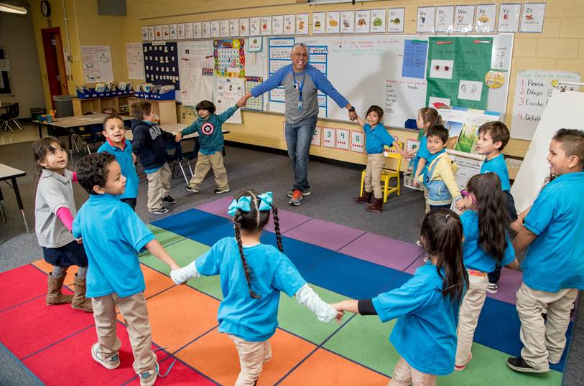
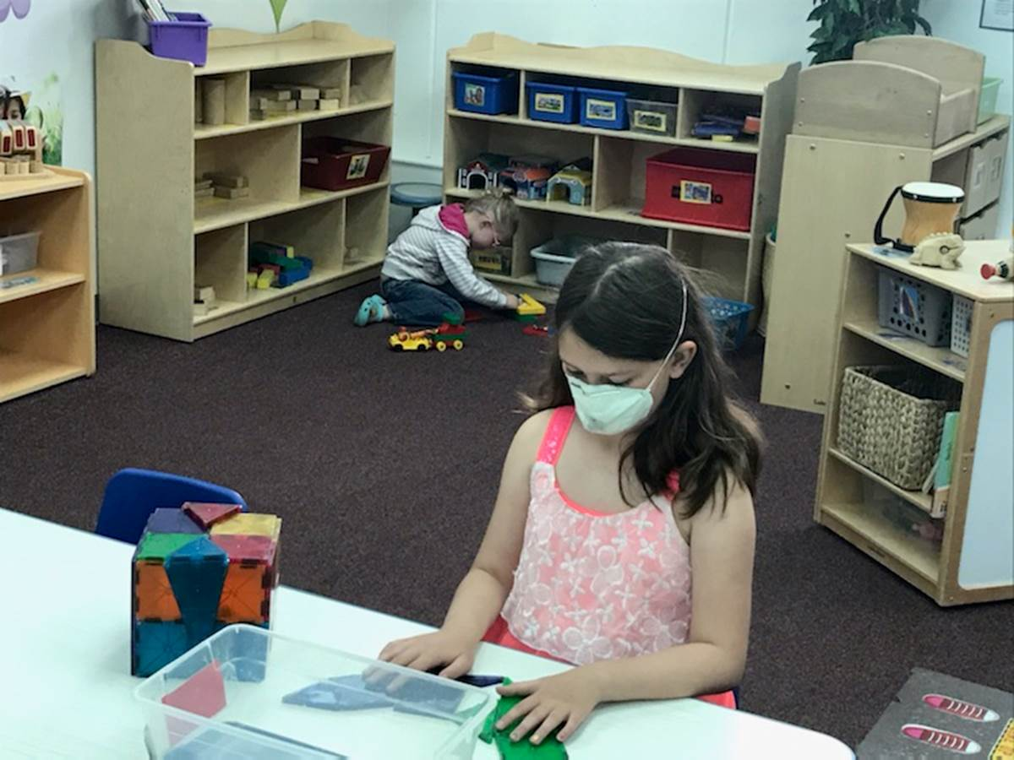
Pivot and Reset to Support Educators in the Creation of Quality Learning Opportunities for Young Children in a New Normal
Ways to support and engage educators:
Relationships are more vital than ever, they are KEY
Open channels for timely two-way flow of information
Provide the structures needed for teachers to feel they have solid footing
Develop ways to establish a new sense of “normalcy” in this unusual time

