Slide 1
Serving adult learners in California Community Colleges: 8.5 million reasons to do it right

Slide 2
What is a “Non-Traditional” Adult Learner?
Almost all community college students are adults
“Traditional” adult learners typically enroll right after high school and are age 18-24
We define “non-traditional” adults as those age 25+

Slide 3
What do we know about non-traditional adult learners?
Characteristics
Needs
Work, family obligations
Work experience and training
“Soft skills” like independence, communication, time management
Financial aid
Credit for prior learning
Flexibility in timing of courses and support services
Child care
Representation in the campus culture
Notes:
Affordability:
Financial aid often not geared for non-traditional adults
Actual costs and opportunity costs of attending are high, but pay-off is worth it for future economic mobility
Logistics
Most are part-time because they have jobs and families Child care, timing of courses, availability of tutoring and counseling (they need evenings and weekends)
Campus Culture
Do non-traditional adults see themselves reflected in student government, on websites and in media?

Slide 4
Why focus on them?
Current students:
42% of students enrolled in California Community Colleges in 2016-17 were age 25+ (~900,000)
Potential students:
8.5 million working age Californians who lack a college credential
Increasing educational attainment will drive greater economic mobility for ALL Californians and contribute to the state’s economy
Increasing completion helps boost colleges’ funding through the new Student Centered Funding Formula

Slide 5
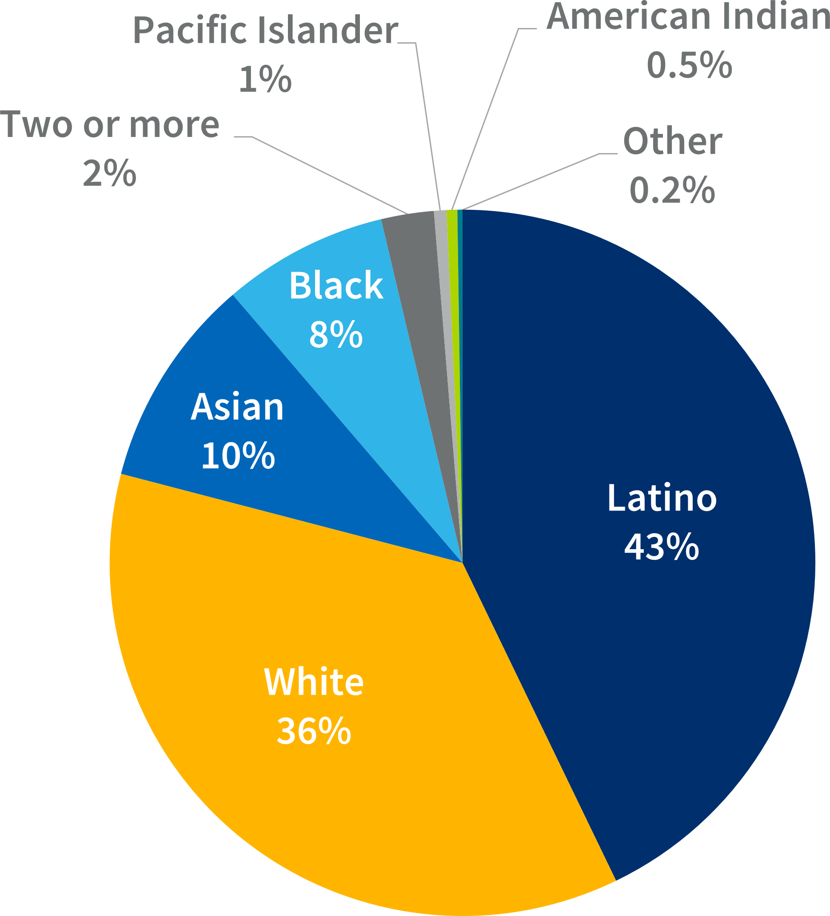
California residents age 25-54 with a high school diploma or some college, 2016
Equity imperative
Notes:
Serving adult learners is an equity imperative

Slide 6
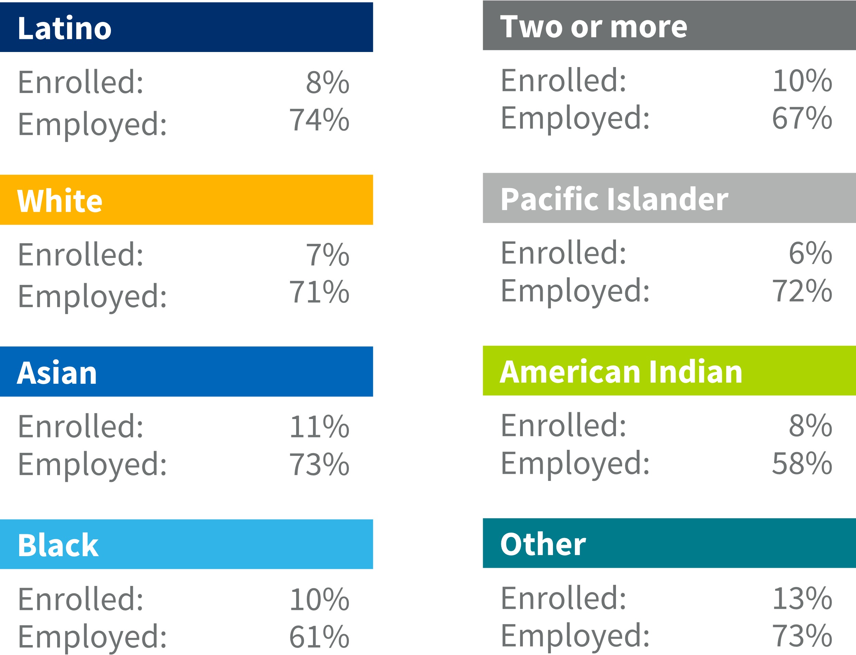
Opportunity
Employment and enrollment in college of California residents age 25-54 with a high school diploma or some college, 2016

Slide 7
How do we currently serve them?
Opportunity to learn: Adult Promise grant from Lumina
Solid structure in place so far:
Strong Workforce program
Adult Education initiatives through the California Adult Ed Block Grant
Incarcerated Student Education
Online Education Initiative
Room for improvement
Financial Aid
Notes:
Adult Promise grant: Landscape analysis with central question: What programs and services are currently serving this population?
Student focus groups with central questions: What has been your experience with these programs and services? How can we better communicate about the range of options for you?

Slide 8
How are we changing?
Two initiatives: Credit for Prior Learning and Online College
Credit for prior learning
Policy window: legislation in 2018 (SB1071 and AB1786) and a grant from the Lumina foundation
Policy changes: New statewide regulation
Practice changes: Expanded prior learning assessments that focus on competencies, including “cross-walks” from military training and industry credentials
Notes:
2019-20 pilots

Slide 9
A New Kind of Community College - Online
Notes:
The development of the new 115th college has been driven primarily by a dual user design. Understanding both the supply and demand sides of the marketplace, it is focused on meeting needs based on research from working adults and hiring managers. Working adults gest real world experience & support through job placement. Hiring managers get access to qualified candidates with validated skills.
Our research showed that: working adults recognize their current job is temporary & unstable. They are craving long term stability. Working adults see the value of an education in helping them get a stable job. Despite knowing how useful college can be, it’s hard to succeed because of how often life gets in the way.
On the flip side: Hiring managers told us that finding qualified applicants is like finding a needle in a haystack - and is a significant pain point. To mitigate churn, hiring managers want to give candidates a realistic sense of the role even before the hiring process begins. Hiring managers are looking for trustworthy ways to validate a candidate’s skills.
The colleges program meet BOTH of these needs.

Slide 10
A New Kind of Community College - Online
Demand-driven and responsive to dynamic economy
Competencies that lead to employer-recognized credentials
Labor market requires a scalable response
Skills that fit well with online delivery model
Support from industry and labor partners
Notes:
In approaching this we also thought a lot about where this college sits relative to the other 114 colleges. To have a unique focus that also drives greater change in the system to improve outcomes for the college’s target demographic—working learners.

Slide 11
A New Kind of Community College - Online
11K Openings through 2024
H.S. Diploma baseline, stackable in HBS
SEIU/UHW, Dignity Health, Optum 360
CCCs currently produce 131 certificates/year
Medical coding will be the inaugural credential in a healthcare business services pathway.
Co-designed with employers aimed at building the skills (competencies) needed to be work-ready.
First beta cohort will launch in October 2019.
The beta launch allows for a test and learn environment that allows the college to test a prototype to create a rapidly scalable online program that results in measurable wage gain and supports career and academic advancement.
$32–$50/hr
Healthcare Business Services: Medical Coding
Essential Skills
Notes:
Consistent with the conditions for deciding programs (previous slide) the inaugural credential chosen is Medical Coding in a Healthcare Business Services pathway. In addition to a technical core, students get “essential skills” contextualized for their pathway to better build the capabilities needed within an industry. Essential skills include: literacy, numeracy, digital, and 21st century “soft skills” needed to succeed in the workplace. Each time a technical credential is needed to stack, we shorten the timeframe because the pathway is built with a foundational base. In a rapidly changing skills landscape, models like this get us closer to meeting the learner needs as working and learning continue to converge in the near future.

Slide 12
Questions?
Jodi Lewis
jlewis@foundationccc.org

