Slide 1
Administrative Preparedness:
An Overview
June 25, 2019

Slide 2

Speaker
Geoff Mwaungulu, JD, MPH
Senior Program Analyst
Preparedness, Law, and Policy
NACCHO
gmwaungulu@naccho.org

Slide 3
Session Outline
Introduction to Administrative Preparedness
Overview of Tools and Resources
Q&A

Slide 4
Defining ‘Administrative Preparedness’
Process and planning activities to ensure that fiscal and administrative authorities and practices that govern funding, procurement, contracting, hiring, and legal capabilities necessary to mitigate, respond to, and recover from public health emergencies can be accelerated, modified, streamlined, and accountably managed through all levels of government.

Slide 5
Why do we care?
Administrative preparedness supports operational response!
H1N1
Ebola
Zika
Notes:
There are many challenges with moving funding from federal to state and local levels and expending the funding. Supplemental funding that became available during response to H1N1 served to highlight many of the operational barriers.
In 2012, NACCHO and ASTHO worked with Harvard University, with funding from the CDC, to conduct an assessment of administrative preparedness barriers. The project had two goals:
(1) Identifying budget/administrative emergency preparedness barriers and challenges local and state health departments encounter when attempting to accept, allocate, spend, monitor, and report federal funding during routine preparedness activities, as well as during emergency situations.
(2) Identifying considerations and practices from the field that provide potentially generalizable promising solutions for enabling accelerated, modified, and streamlined fiscal and administrative tasks under an emergency response framework.
To explore the barriers, challenges, and practices, NACCHO and Harvard conducted a literature review and key informant interviews with state and local public health officials.
The report identified the following primary challenges:
accepting funding from DHHS
Insufficient time to respond to an FOA
Administrative burden associated with multi-phase funding (H1N1)
Legal and legislative requirements for approval of funding at the local level
Allocating PHEP funding from state to local to health departments
Substantial variance in processes for how funding is allocated to local health departments and how local funding needs are determined and prioritized
Spending funding
Lengthy and cumbersome procurement processes
Lengthy and cumbersome hiring processes
Restrictions (from funding authorization, federal or state requirements) on how funding can be spent
Monitoring/Reporting
Large variability in monitoring systems or software – many “home grown” systems
Conflicting terminology among federal, state, and local entities
Lack of systematic processes for collecting standardized information
EBOLA:
Progress has been made, but the Ebola response highlighted continued challenges. In August 2015, ASTHO and NACCHO co-hosted an in progress review of the Ebola response with federal, state, and local public health, healthcare, and other key partners involved in the Ebola response. The participants identified several challenges related to administrative preparedness during the Ebola response, including:
Delays in receiving supplemental funding from federal government, and in turn, state health departments - Delays are due to a variety of factors at multiple levels, including an initial lengthy and politically charged Congressional approval and appropriations process, as well as state and local regulations and processes for accepting and receiving funds. These delays are even more pronounced at the local level, because funding must go through state awardees and intermediaries before reaching the end user (e.g., hospital, healthcare coalition, local health department, or laboratory).
Challenges spending funds down because of restrictions on the use of funding (disease specific nature of the funding) and state and local laws, regulations, and administrative processes impeding rapid obligation of funding through contracts, procurement, and staffing.
Exercising isolation and quarantine authorities – media and public scrutiny, understanding roles and responsibilities among public health, law enforcement, and other partners in exercising authorities.
ZIKA
Delayed congressional funding – redirect funding from other sources?
Staffing – multi-sectoral response – how do we leverage staff and subject matter experts who aren’t “preparedness”?

Slide 6
NACCHO 2018 Preparedness Profile
Most LHDs indicated they have at least one expedited procedure in place to address administrative needs during a public health emergency. Compared to 2016, more LHDs indicated having these procedures in place either informally or formally.
However, more than one-quarter of LHDs reported not having workforce surge procedures in 2018. In addition, approximately 20% were unsure whether they have these procedures in place.
Small LHDs were most likely to not have any procedures in place. The most common barrier to administrative preparedness reported was lack of dedicated resources, followed by lack of available tools and resources.
Expedited Procedures for Administrative Preparedness
Percent of respondents (excluding those reporting not sure)
Not in place
Informally in place
Formally in place
n=289–309

Slide 7
Administrative Preparedness Areas of Focus
Procurement
Workforce
Funding
Declarations and Authorities
Reporting

Slide 8
Administrative Preparedness Areas of Focus
Declarations and Authorities
Make declarations?
Procure resources?
Take action regarding personnel?
Who has the authority to...
Waive requirements?

Slide 9
Administrative Preparedness Areas of Focus
Procurement
Common procurement vehicles can include:
Mutual Aid Agreements
Term Contracts
Cooperative Purchasing
Procurement Cards “P-Cards”
Emergency Procurement Provisions
Processes involved in obtaining resources to address public health needs.

Slide 10
Administrative Preparedness Areas of Focus
Workforce
Appropriately sized and skilled workforce
Governmental employment systems
Workforce liability protections
Common issues can include:
Ensuring your workforce is appropriately sized and protected during a public health event

Slide 11
Administrative Preparedness Areas of Focus
Funding
Common barriers include
Restrictions on use of funds
Timing of receipt of funds
Accepting and allocating funds
Gaining access to financial resources in a more timely fashion

Slide 12
Administrative Preparedness Areas of Focus
Reporting
Common reporting issues include:
Duplicative and inconsistent nature or reporting requests
Difficulty of anticipating reporting needs for all hazards
Differing perspectives on timeliness and utility of some requested data
Keeping up with reporting requirements in the middle of a response

Slide 13
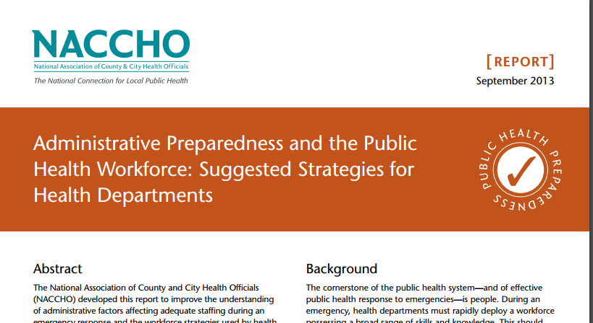
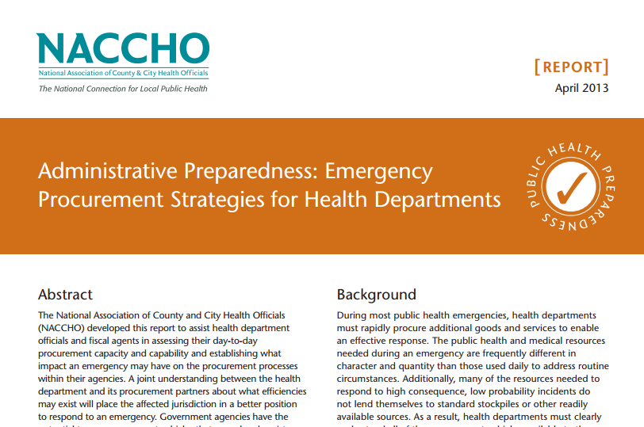
How do you face these challenges?
Awareness / Education
Promising Practices
Performance Measurement
Exercise and Evaluation
Tools and Resources
Notes:
The report also identified promising practices and methodologies from state and local health departments that may assist in overcoming some of the barriers and challenges. NACCHO documented the practices in a series of reports which are available on NACCHO’s bookstore: www.naccho.org
Admin Prep Authorities
Administrative Preparedness and the Public Health Workforce: Suggested Strategies for Health Departments
Emergency Procurement Strategies
Reporting Strategies

Slide 14
Administrative Preparedness Experiences
Would anyone like to share experiences they have had with Administrative Preparedness?

Slide 15
Session Outline
Introduction to Administrative Preparedness
Overview of Tools and Resources
Q&A

Slide 16
Overview of Tools and Resources
NACCHO Toolbox (www.toolbox.naccho.org)

Slide 17
Overview of Tools and Resources
Fact Sheets
Authorities
Procurement
Reporting
Workforce
RAPID Site Toolkits
Administrative Preparedness Legal Guidebook
Guide for Incorporating Administrative Preparedness in Exercise

Slide 18
Resources for Administrative Preparedness Implementation and Development (RAPID) Demonstration Sites
CDC-funded project to develop locally-created tools for Administrative Preparedness
Medina County Health Department (IL)
Cost Estimator
Mercer County Health Department (IL)
Administrative Preparedness Guide
New Orleans Health Department
Resources
Public Health – Seattle and King County
TTX Kit

Slide 19
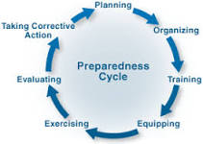
Methodology
Assessment

Slide 20
Mercer County Health Department
Administrative Preparedness Guide
7-Step Process for Addressing Administrative Preparedness
Assess administrative preparedness level
Define ‘Emergency’
Define ‘Disaster’
Determine Authorities
Determine Process for State of Emergency
Determine Process for Disaster Declaration
Complete Procurement/Personnel Policies

Slide 21
Administrative Preparedness Guide
Step 1 – Assess Administrative Preparedness Level
Important to assess:
Understanding of administrative preparedness
Current policies, procedures, and plans
Barriers to quick and effective response
Knowledge of who has what authorities?

Slide 22
Administrative Preparedness Guide
Step 2 – Define ‘Emergency’ for your Community or Jurisdiction
Using relevant state and local laws, define what falls within the definition of ‘emergency’ or ‘public health emergency’ in your community

Slide 23
Administrative Preparedness Guide
Step 3 – Define ‘Disaster’ for your Community or Jurisdiction
Using state and local laws where relevant, define what falls within the definition of ‘disaster’ in your community

Slide 24
Administrative Preparedness Guide
Step 4 – Determine the Authorities
Consider the differences in authority based on emergency and non-emergency situations
Identify, with partners, those job titles that are associated with administrative preparedness activities to ensure a coordinated response

Slide 25
Administrative Preparedness Guide
Step 5 – Determine Process for Declaring “State of Emergency”
It is possible to develop an algorithm for declaring a “state of emergency” should your organization have the legal power to do so.
When developing your algorithm, consider the following aspects:
Realization of impending emergency
Determination that action needs to take place
Identification of authorities to include in declaration
Provision of awareness to relevant entities

Slide 26
Administrative Preparedness Guide
Step 6 – Determine Process for “Declaring a Disaster”
An algorithm may also be developed for the declaration of a disaster.
Similar considerations to declaring a state of emergency

Slide 27
Administrative Preparedness Guide
Step 7 – Understand/Update Procurement & Personnel Policies
Procurement can be a complicated process to put in place due to the terminology involved and the different/increased provisions needed to respond to an emergency. Additionally, there is often a disconnect or lack of joint planning between agencies and the overarching fiscal entities.
Personnel actions can be especially difficult in rural areas where staff can be limited. May overcome with volunteers, approved overtime, temp staff, and other strategies.

Slide 28
Resources for Administrative Preparedness Implementation and Development (RAPID) Demonstration Sites
CDC-funded project to develop locally-created tools for Administrative Preparedness
Medina County Health Department (IL)
Cost Estimator
Mercer County Health Department (IL)
Administrative Preparedness Guide
New Orleans Health Department
Resources
Public Health – Seattle and King County
TTX Kit

Slide 29
About the Seattle & King County Toolkit
Public Health – Seattle & King County developed an adaptable tabletop exercise that will guide LHDs in engaging staff in discussions related to administrative preparedness in a public health emergency response scenario.
The toolkit contains the following:
User Guide
TTX PowerPoint w/ notes
Evaluation Materials

Slide 30
Exercise Planning
Setting the stage (buy-in)
Planning Team
Planning Meetings
Objectives
Participants
Logistics

Slide 31
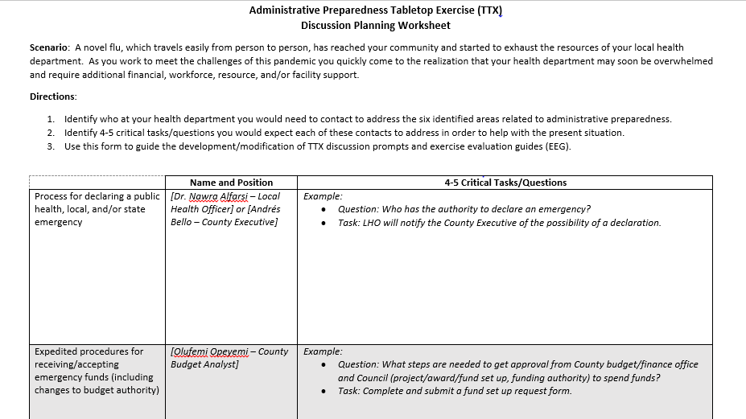
Discussion Planning Worksheet
Helps the planning team generate discussion prompts to guide the TTX

Slide 32
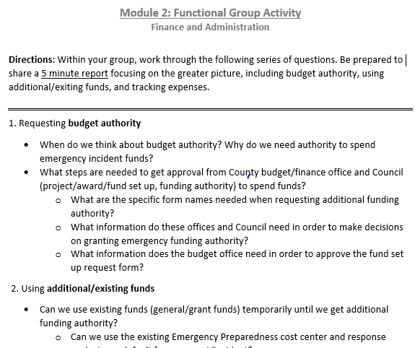
TTX Presentation Materials
Facilitator Guide & Participant Handout
Functional Group Activity
Slides

Slide 33
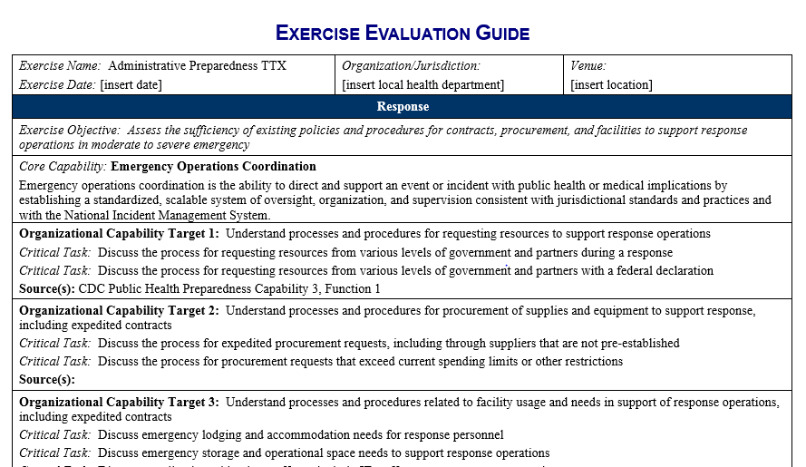
Evaluation
Participant Feedback Forms
Exercise Evaluation Guides
After Action Report / Improvement Plan

Slide 34
Overview of Tools and Resources
Fact Sheets
Authorities
Procurement
Reporting
Workforce
RAPID Site Toolkits
Administrative Preparedness Legal Guidebook
Guide for Incorporating Administrative Preparedness in Exercise

Slide 35
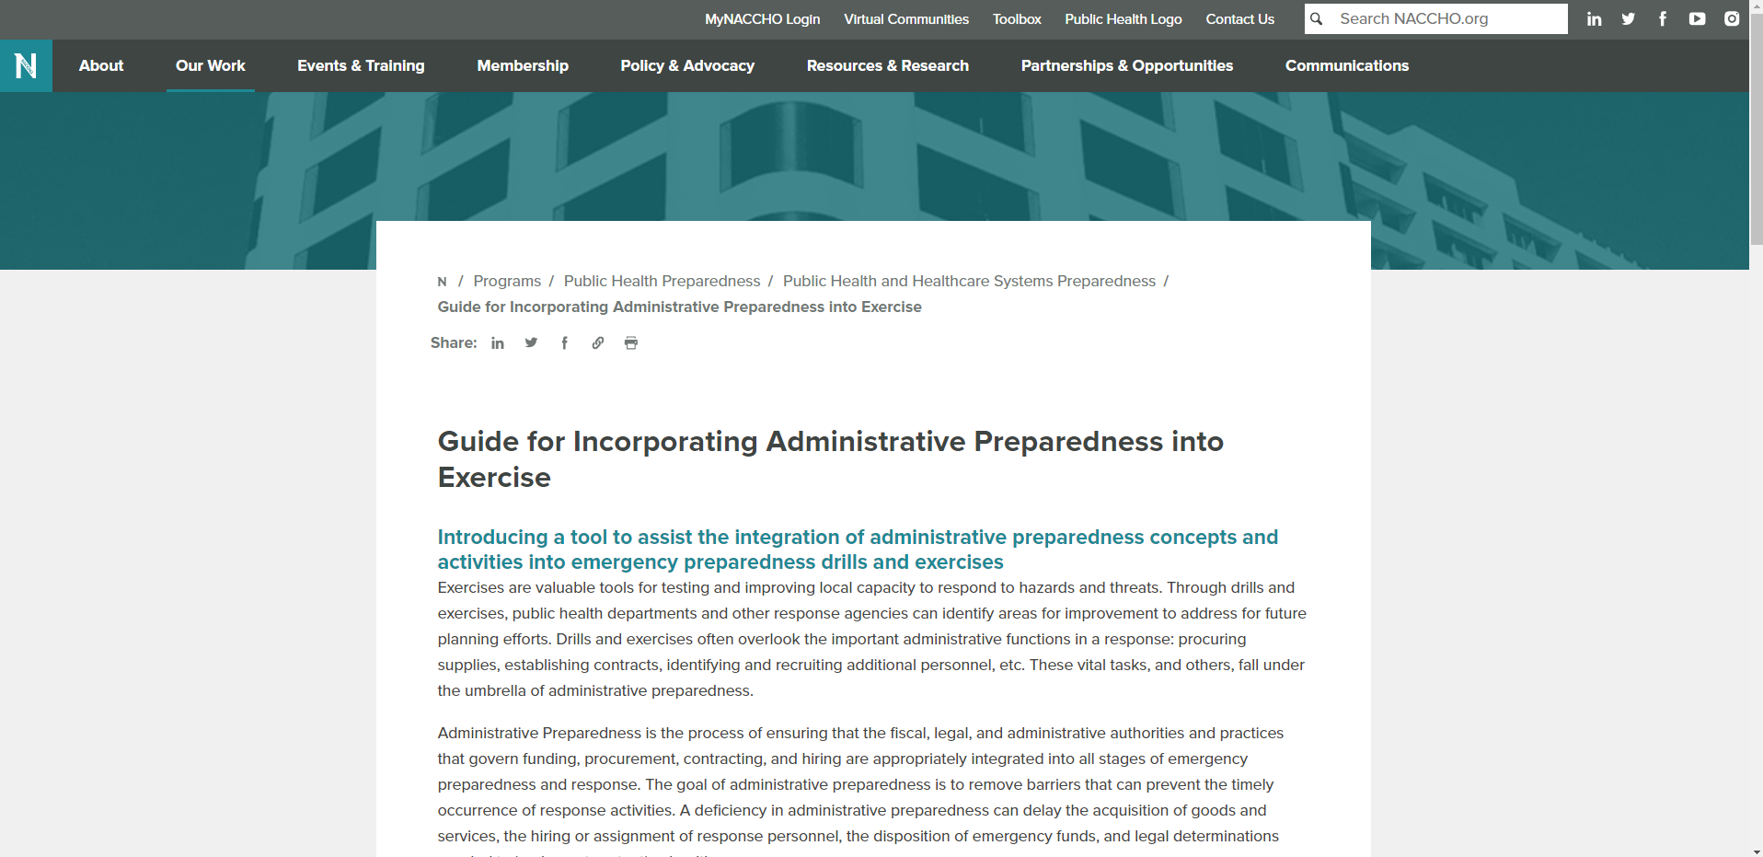
Guide for Incorporating Administrative Preparedness into Exercise
Organized around the Homeland Security Exercise and Evaluation Program (HSEEP)
Contains sections regarding
Exercise Design
Exercise Improvement Planning
Serves as a tool that may be used for integrating administrative preparedness principles into exercise
Exercise Conduct
Exercise Evaluation
Promising Practices & Lessons Learned
Example Injects

Slide 36
Overview of Tools and Resources
Fact Sheets
Authorities
Procurement
Reporting
Workforce
RAPID Site Toolkits
Administrative Preparedness Legal Guidebook
Guide for Incorporating Administrative Preparedness in Exercise

Slide 37
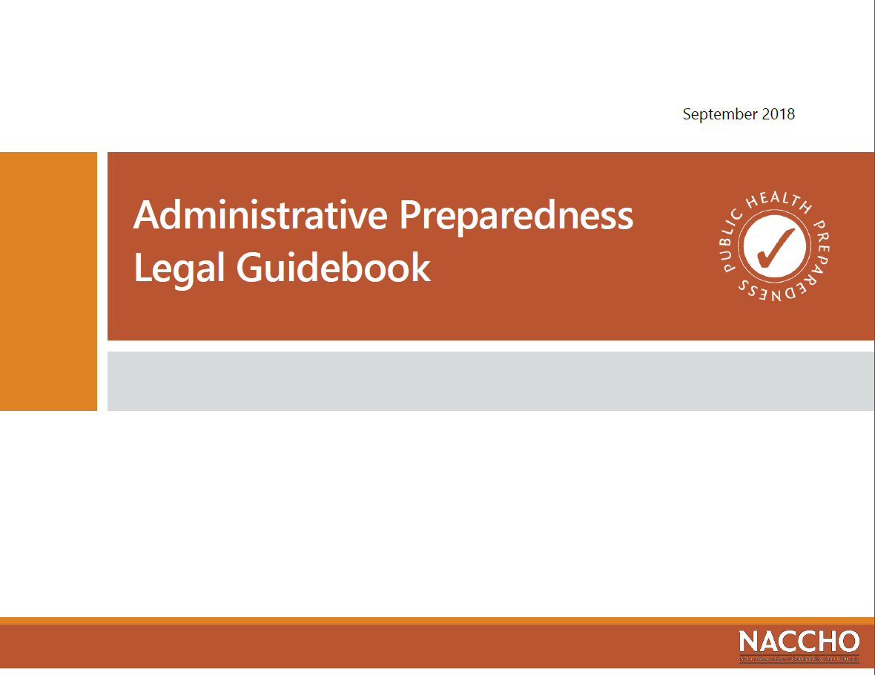
Administrative Preparedness Legal Guidebook

Slide 38
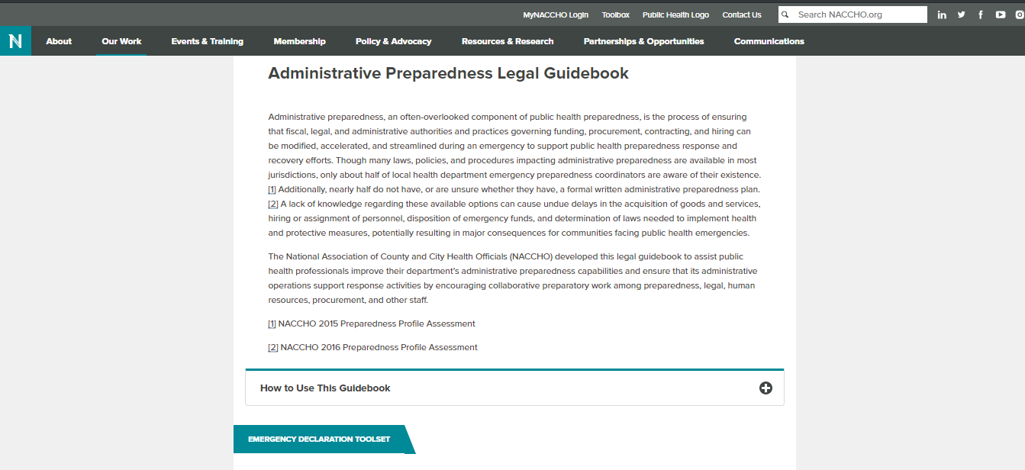
Administrative Preparedness
Legal Guidebook
Contains sections addressing
Declarations
Resource for assisting states and locals as they take administrative preparedness into consideration during their emergency planning efforts through the use of
Procurement
Staffing
Mutual Aid Agreements and Memorandum of Understanding
Visual Pathways
Decision-Aids
Notes:
The Administrative Preparedness Legal Guidebook was created to serve as a resource for health departments to better organize their efforts surrounding administrative preparedness.
Through this project, NACCHO wanted to create a set of customizable tools that could be used by health departments, regardless of legal jurisdiction and organizational structure resulting from variance in governance, to establish or refine their administrative preparedness plans and procedures. To do so, NACCHO conducted informational interviews of subject-matter experts from local health departments and NACCHO’s partners. Through these discussions NACCHO identified four areas of focus for the proposed tools:
emergency declarations,
emergency procurement,
expedited staffing, and
mutual aid.
Following the identification of these areas of focus, NACCHO staff then reviewed laws from a selection of jurisdictions to identify high-level commonalities for each of the aforementioned areas. These identified commonalities were used as the basis for the creation of high-level customizable decision-aid and visual pathway tools for each of the previously identified areas of focus. Each of these tools may be edited by users to include jurisdiction specific law and policies.
These tools may be leveraged by health departments on for the development of formal administrative preparedness plans developed through the encouraged cooperation of the various health department staff members involved in administrative preparedness.

Slide 39
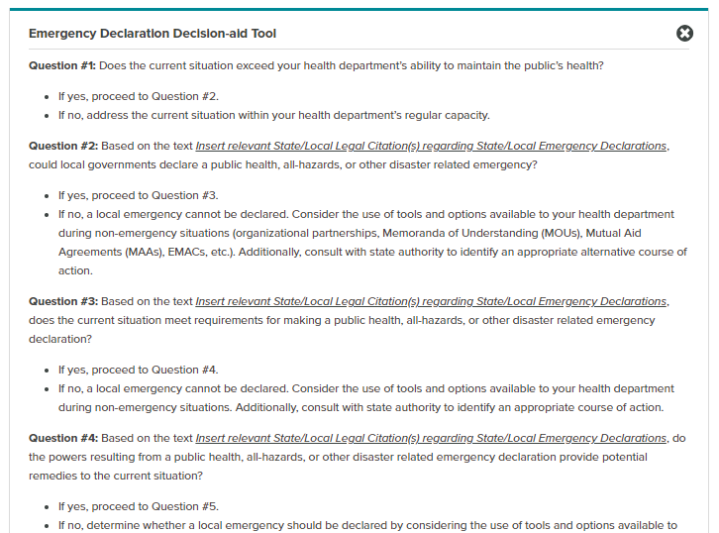
Administrative Preparedness Legal Guidebook – Decision Aid Tools
Notes:
These decision aids can assist health department staff by providing the basics of an administrative preparedness planning outline that may be augmented and customized for the purposes of the jurisdiction through the use of editable word document versions of the tool available through the online legal guidebook.
Process for using decision-aid tools:
Begin using each decision-aid with “Question #1”
Please read the question and corresponding answers in their entirety before answering each question
Answer each question using “yes” or “no” responses and closely follow the instructions. Some answers will instruct users to proceed to the following question while others will refer to different documents or suggest alternative courses of action
Consult with legal counsel and other relevant staff (e.g., procurement, human resources, health department administration, etc.) to identify and insert appropriate state and local laws, policies, or procedures into the underlined locations in the decision-aid tools
Use decision-aid in conjunction with its corresponding visual pathway from the same toolset to gain high-level perspective on progression through the described process

Slide 40
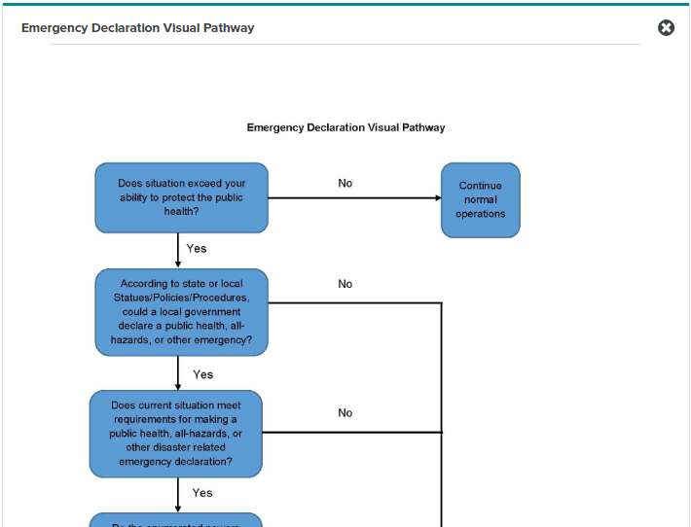
Administrative Preparedness Legal Guidebook – Visual Pathway Tools
Notes:
Intended for use by the more visual among us, these pathways help to provide insight as to where certain activities fit within the larger scheme of the area of preparedness
Process for using Visual Pathways
Start by reading and answering the first question featured in pathway
Follow the path matching your response to the most recently answered question and continue to follow the pathway until you have answered all the questions
Use visual pathway in conjunction with its corresponding decision-aid from the same toolset to gain additional insight regarding suggested courses of action, state/local law, policies, and procedures

Slide 41
Overview of Tools and Resources
Fact Sheets
Authorities
Procurement
Reporting
Workforce
RAPID Site Toolkits
Administrative Preparedness Legal Guidebook
Guide for Incorporating Administrative Preparedness in Exercise

Slide 42
Overview of Tools and Resources
NACCHO Fact Sheets
Authorities Fact Sheet
Procurement Fact Sheet
Reporting Fact Sheet
Workforce Fact Sheet

Slide 43
Collection of NACCHO Administrative Preparedness Resources
Fact Sheets
Administrative Preparedness: Emergency Procurement Strategies for Health Departments http://toolbox.naccho.org/pages/tool-view.html?id=5241
Administrative Preparedness: Emergency Reporting Practices for Health Departments http://toolbox.naccho.org/pages/tool-view.html?id=5242
Administrative Preparedness Legal Guidebook
Direct URL: https://www.naccho.org/programs/public-health-preparedness/systems-preparedness/administrative-preparedness-legal-guidebook
Search for “legal guidebook” on www.naccho.org
Administrative Preparedness Authorities: Suggested Steps for Health Departments http://toolbox.naccho.org/pages/tool-view.html?id=5239
Administrative Preparedness and the Public Health Workforce: Suggested Strategies for Health Departments http://toolbox.naccho.org/pages/tool-view.html?id=5240
Guide for Incorporating Administrative Preparedness into Exercise
https://www.naccho.org/programs/public-health-preparedness/systems-preparedness/administrative-preparedness-exercise-guide
NACCHO Toolbox: Administrative Preparedness Toolkit (including tools developed by LHDs)
http://toolbox.naccho.org/pages/index.html
(Select “Administrative Preparedness Toolkit” from dropdown menu)
Notes:
Information on where to find resources

Slide 44
Overview of Tools and Resources
Non-NACCHO Resources may be found through
Association of State and Territorial Health Officials (ASTHO)
National Conference of State Legislators (NCSL)
National Governors Association (NGA)
US Conference of Mayors (USCM)
National Association of Counties (NACo)
National Association of State Procurement Officials (NASPO)

Slide 45
Session Outline
Introduction to Administrative Preparedness
Overview of Tools and Resources
Q&A

Slide 46
Questions?

Slide 47
Thank You!
Geoff Mwaungulu, JD, MPH
Senior Program Analyst
Preparedness, Law, and Policy
NACCHO
gmwaungulu@naccho.org

